Slide 1
Module 9
CSR Adaptation to Circular Economy Innovation
"The European Commission support for the production of this publication does not constitute an endorsement of the contents which reflects the views only of the authors, and the Commission cannot be held responsible for any use which may be made of the information contained therein 2020-1-DE02-KA202-007503’
This resource is licensed under CC BY 4.0

Slide 3
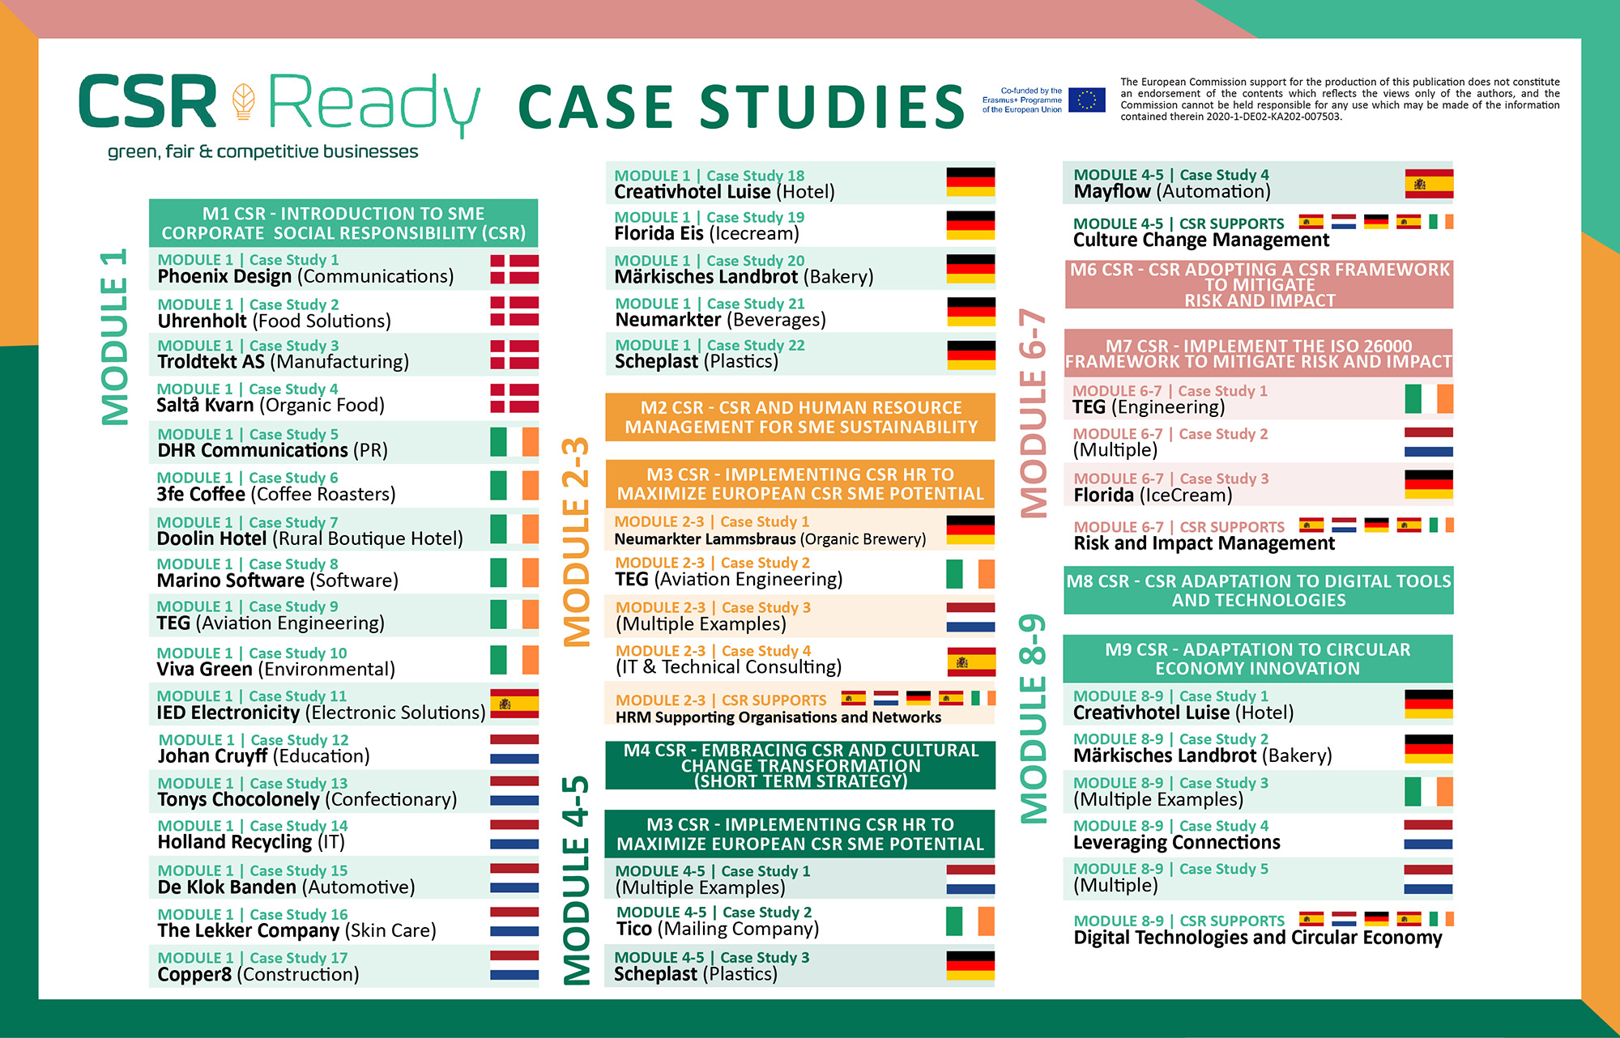

Slide 4
Overview of Module 9
Contents
This module explains circular economy innovation and different CE model framework approaches that work in alignment with CSR. It demonstrates how Circular Economy is the perfect tool that can advance businesses forward by moving away from a resource-hungry linear model to a model that has little impact, is sustainable, and extends product life cycles. CE is a bit complex but well worth the investment, especially since being reactive doesn’t work anymore given our predictable vulnerable world. This module uses strategies that are aligned with global agenda items, future regulatory frameworks and climate change measures that will inevitably be part of our living systems so we can protect our planet and prepare for future generations.
1
Understanding Circular Economy Measures and How it Encapsulates CSR Activities
2
Join the Global Circular Economy Effort and Conversation
3
Implementing Circular Economy Models

Slide 5
Learning Outcomes
Understand the difference between the traditional linear model to the circular economy model
Learn why companies need to engage in CE to not only gain control over their resources but to factor in environmental regulation
Become aware of how the Circular Economy can provide a beneficial way of doing business sustainably and how it can be equally beneficial to people and the planet
Learn from numerous European case studies in a variety of industries how they have approached CE Models for their businesses
Learn how to join the Circular Economy effort and conversation by implementing core principles and activities

Slide 6
Understanding Circular Economy Measures and How it Encapsulates CSR Activities
This section explains how Circular Economy complements CSR measures, digital innovation and responsible SME advancements assisting businesses to move away from a resource-hungry linear model where virgin materials are extracted, used, and discarded at the end of their life; to one which focuses on raw material reduction, retention and reuse.
Section 1

Slide 7
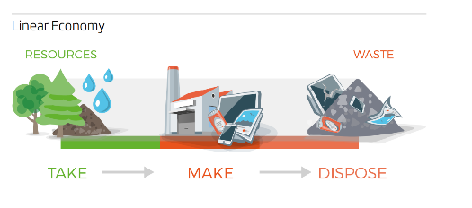
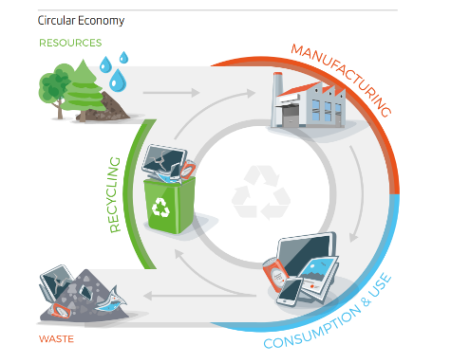
What is Circular Economy?
The circular economy is a model of production and consumption, which involves sharing, leasing, reusing, repairing, refurbishing and recycling existing materials and products as long as possible. In this way, the life cycle of products is extended.
The key difference is that the linear economy focuses on profitability, irrespective of the product life cycle, whereas the circular economy targets sustainability
Source

Slide 8
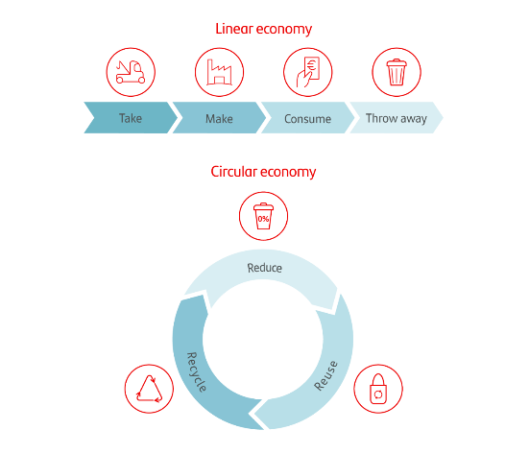
Linear Versus Circular Economy
The traditional linear model prioritizes profit over sustainability, with products made to be thrown away once they’ve been used. Raw materials are collected and transformed into products that consumers use until they discard them as waste, with no concern for their ecological footprint and consequences.
Circular Economy is where production has as little impact as possible on the environment by leaving less footprint. Companies try to make production as sustainable it does this by following three principles: reduce, reuse y recycle.
Source

Slide 9
Why Do Companies Need to Engage in Circular Economy Activities
The economy, SMEs and industry are key to fighting climate change. That’s why they must continue the shift from a linear to a circular economy to make sure society progresses in a way that is environmentally friendly. The planet’s resources are finite, so it’s crucial that people, governments and companies work together to use them more responsibly. Enter the circular economy, a new model that offers an alternative to the traditional linear economy.

Slide 10
How Businesses can Benefit from Circular Economy
Circular Economy Activities benefit not only companies but people and the planet. The benefits are endless such as; achieving cost savings, increasing competitiveness, stimulating innovation, reducing pressure on the environment, improving the security of the supply of raw materials, and boosting economic growth for Ireland.
Currently, the production of materials we use every day in Europe this accounts for 45% of the CO2 emissions.
Waste prevention activities, ecodesign , and re-useability could save companies money while also reducing total annual greenhouse gas emissions. Learn from Our CSR READY Case Studies How they benefited.
Source

Slide 11
GDP Benefits of €4.3 Trillion in 2030
Widespread adoption of the circular economy results in increased Gross Domestic Product (GDP)—with a reported €4.5 trillion in economic benefits until 2030. But this does not only provide a general economic boost. Individual businesses that practice a circular economy can also reap the monetary benefits.
Take the consumer goods industry. There is €3.2 trillion worth of materials used in this sector alone each year, yet only 20 per cent of those materials are recovered.
The ability to reuse materials in the production of new products instead of sourcing new materials can, in the long run, reduce operational costs. Reusing existing materials also takes away from an industry’s dependency on resources that are otherwise volatile, whether in price or availability.

Slide 12
Comply with Environmental Regulations & Manage Reputation
Gain control over resources; In a more relational sense, a company can also find itself in deep trouble if its processes rely on a certain material that can only be sourced from a singular place. This entire company would be jeopardized if any geopolitical or environmental crises made that resource unavailable to them. By gaining control over their resource supply and cycles, companies can become more independent and sustainable.
Environmental Regulation; Another factor is the environmental trend and corresponding regulations that already exist and more stringent that follow are being further enforced as climate change gets worse.

Slide 13
CE Enhances Sustainability, Increases Brand Reputation, Higher Productivity…and more.
CE is proving to alter the traditional linear business model to circular (design, procurement, production, consumption, and recover) using reduce, reuse and recycle principles (Prieto-Sandoval et al., 2018).
Closed loop supply chain functions (i.e., design, procurement, production, distribution, usage and reverse logistics) enable adoption of CE which will enhance the sustainability performance. There are several benefits and opportunities (Prieto-Sandoval et al., 2018) for SMEs adopting CE such as increased brand reputation, cost reduction (operational), business growth, higher productivity (throughput), recovery of the environment through reduced CO2 emission, and greater sustainability. The study by Prieto-Sandoval et al. (2018) reveals that the most motivating aspect of CE adoption is cost savings compared to building brand reputation and regulatory pressure.
Source:

Slide 14
The Circular Economy goes beyond the management of waste. The focus is on reducing the amount of raw materials we use and maximising the value of materials along the production and consumption chain. Waste is recycled where possible and brought back into production processes. Otherwise, it is used to create energy instead of disposed to landfill. The Circular Economy graphic shows the different stages of the circular economy. (EPA and the Irish Circular Economy)

Slide 15
Access to Grants and Supports
S
Most countries have Circular Economy Programmes as a driving force for more sustainable ‘circular’ economies. Their purpose is to ensure that everyone uses less resources and prevents waste to achieve sustainable economic growth. Part of these programs includes access to supports, competitiveness strategies, innovation grants and seed funding to support circular economy initiatives. They implement actions that build knowledge, pool resources, and build alliances and evidence to inform and build circular economies. They realise and drive enterprise opportunities of a circular economy by supporting new business models and promoting resource efficiency.

Slide 16
Employment
S
Employment As the circular economy spurs greater sustainable innovations and production processes, there need to be jobs to maintain them. The potential for growth in this sector—for both capital and jobs—can only go up.
SMEs represent about 90% of businesses and more than 50% of employment worldwide (World Bank Finance, 2021). For the EU, the average value that SMEs contribute to the economy is around 56 per cent. During 2017, SMEs in the EU (approximately 25.1 million) employed over 94 million people, or approximately 66 percent of the workforce (Statista, 2021).

Slide 17
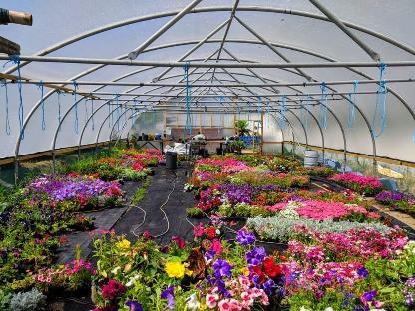
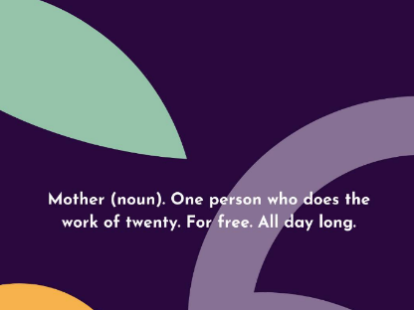
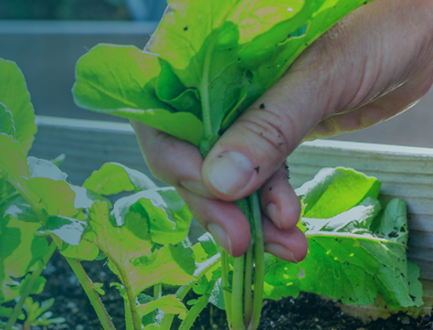
Olive Feed, Ireland has created a new food from olive ‘waste’ for the Wagyu beef market. Olive waste is used as animal feed for this very expensive meat and other animals.
PACE, Ireland is a voluntary sector company that works with people with convictions for safe integration into the community e.g., creating employment opportunities
Kindora Ireland helps families buy the best items for their kids without costing the earth. It saves waste where people can buy, sell and rent baby and kids goods.
Circular Economy Irish SME Examples (also see CSR READY Case Studies)
The Kind, Ireland sell over 100 brands of sustainable, ethical and eco-friendly products that are kind to the body, mind and planet.
Huku Balance, Ireland design and make balance boards using natural, sustainable materials. All packaging and materials are biodegradable. Products have a lifetime guarantee.
GIY, Ireland supports people around the world to live healthier, happier and more sustainable lives by growing some of their own food.

Slide 18
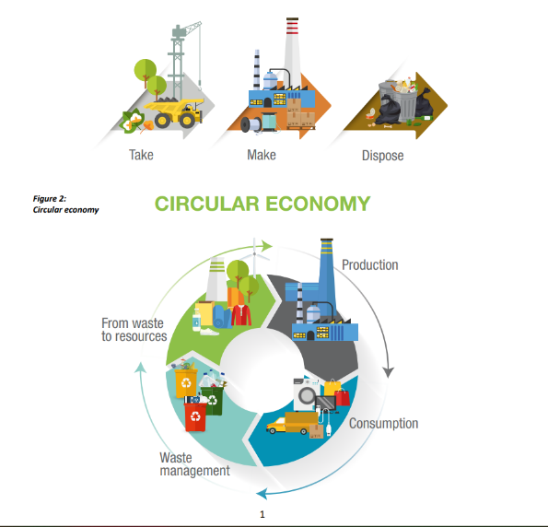
Presents New & Better Business Models for Sustainable Growth
S
The circular economy, demonstrates different but better ways, models and technologies of production that are capable of generating a restorative and regenerative model of production and provision of services. For example relying on renewable energies to reduce and mitigate the negative externalities of climatic change, and environmental toxicity, and to improve biodiversity. Save money, and make business operations effective and efficient while saving the environment and planet under the circular economy management nutrients of
Rethink, Redesign, Recycle Reduce, Repair, Renew, Recover, Reuse

Slide 19
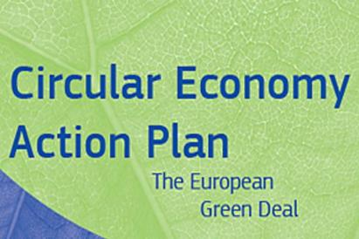
Its an EU Directive and Agenda Priority
S
The European Commission adopted the new circular economy action plan (CEAP) in March 2020. It is one of the main building blocks of the European Green Deal, Europe’s new agenda for sustainable growth. The EU’s transition to a circular economy will reduce pressure on natural resources and will create sustainable growth and jobs. It is also a prerequisite to achieving the EU’s 2050 climate neutrality target and halting biodiversity loss.
It targets how products are designed, promotes circular economy processes, encourages sustainable consumption, and aims to ensure that waste is prevented and the resources used are kept in the EU economy for as long as possible. It lists five priority areas: plastics; food waste; critical raw materials; construction and demolition; and biomass and bio-based products. (Source)
Download Article https://environment.ec.europa.eu/strategy/circular-economy-action-plan_en
Download Action Plan

Slide 20
Join the Global Circular Economy Effort & Conversation
Section 2

Slide 21
Join the Global Circular Economy Effort & Conversation
Corporate social responsibility (CSR) and circular economy (CE) combine have considerable importance in the efforts for sustainable development, lets' discuss why!
“Reduce, reuse, recycle” is the global conversation surrounding sustainability efforts and initiatives. However, the 3 R’s are often discussed by people/customers and need more businesses to join the conversation.
Businesses need to lead the change of implementing CSR, circular economy initiatives and sustainable strategies.
After all, the circular economy is good business. When businesses implement sustainable practices, they are not only helping the environment but the company as a whole. Let’s dive deeper into the ways businesses can work towards these benefits and commit themselves to corporate social responsibility.

Slide 22
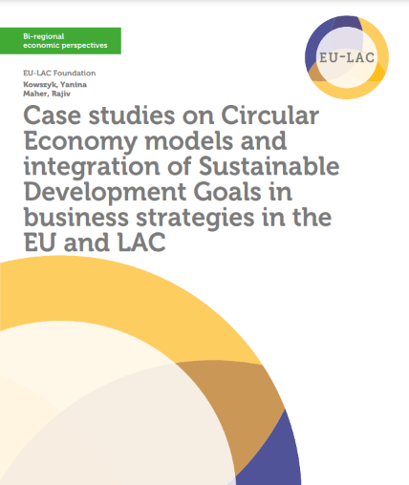
Core Principles of Circular Economy
A circular economy believes that all elements of production have a part to play and can eventually reach a place where they are continuously reused. Core principles of a circular economy include:
Design: Eighty per cent of environmental impacts are determined in the design stage. Circular economies demand sustainable design principles and intentionally opt into the use of recyclable, compostable, or consumable materials.
Durability: Creating long-lasting products is crucial to delaying potential waste or energy use that occurs at the end of a product’s life cycle.
Regeneration: It’s important that we source all energy from sustainable sources and work to create and support regenerative systems.
https://eulacfoundation.org/en/system/files/case_studies_circular_economy_eu_lac.pdf

Slide 23
Why Sustainable Supply Chains and Manufacturing?
Not only does a circular economy model protect our earth’s natural resources and reduce the amount of greenhouse gas in the environment, but it has also been shown to boost the economies and profit margins of businesses that adopt the practice.
80 per cent of a company’s greenhouse-gas emissions come from its supply chains, so targeting this process specifically can result in enormous benefits for our environment. In addition, supply chains are the source of 90 per cent of a business’s direct impact on our air, land, and water supplies.
SOURCE

Slide 24
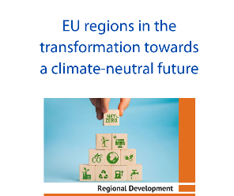
The European Union's (EU) target to become carbon neutral by 2050 is not achievable unless larger companies include small and medium-sized enterprises (SMEs) in their supply chain within formers' carbon reduction programmes. (Source)
Please click the images for recommended reading, guides and toolkits
https://www.europarl.europa.eu/RegData/etudes/STUD/2022/699628/IPOL_STU(2022)699628_EN.pdf
European Circular Economy SMEs Toolkits and Guidelines

Slide 25
Why Cell Phone Recycling?
According to Patrick Byrne, Senior Lecturer in Geography at Liverpool John Moores University, and Karen Hudson-Edwards, Professor in Sustainable Mining at the University of Exeter (UK), gold mining for the tech industry is one of the main causes of deforestation in the Amazon. (Source)
There are approximately 3.5 billion phones in use right now. Their average life span is 2 years. Deloitte Global predicts that smartphones—the world’s most popular consumer electronics device, expected to have an installed base of 4.5 billion in 2022—will generate 146 million tons of CO2 or equivalent emissions (CO2e) in 2022.
The bulk of these emissions, 83% of the total, will come from manufacture, shipping, and first-year usage. In the mobile phone market, many manufacturers offer customers refurbished models at lower prices, as well as cell phone swap programs where users can gain credit towards a new device by returning an old one. (Source)

Slide 26
Why Sustainable Fashion?
Over €500 billion worth of value is lost due to clothing underutilization or lack of textile recycling. Sustainable fashion is a movement in response to the harmful ethical and environmental practices in fast-fashion markets. Fast-fashion clothing has a cheap price tag that does not reflect the expensive negative externalities, estimated to be about €192 billion worth annually.
Sustainable fashion works to lengthen clothing life cycles in both consumer use and product quality and reusability through redesign, repair, or innovative business models that rethink ownership. Sustainable fashion promotes longer wear cycles and sources materials from scrapped clothing or fabric. (Source)

Slide 27
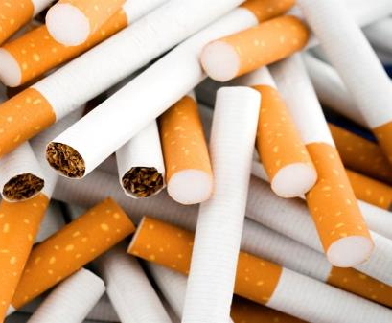
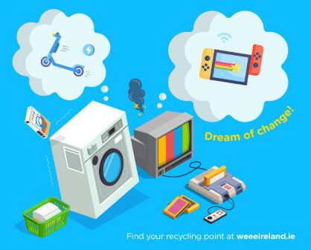
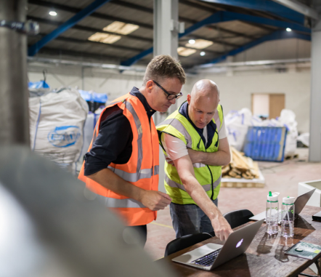
AM Acoustic Materials, Ireland
Provides architectural soundproofing materials offering solutions to commercial, residential and industrial sectors to address noise control issues that are not only recyclable but provide a strong performance.
FiltraCycle, Ireland is a young business that turns cigarette waste into a sustainable source of plastic. Cigarette butts are devasting to the environment, they poison 1000s of litres of water.
weee Ireland collects and recycles all electrical, battery, metal, phone and lighting waste for no charge. During the first lockdown, they lifted a record 3, 763 tonnes for recycling.
Circular Economy Irish SME Examples (also see CSR READY Case Studies
Verifish, Ireland provides software and advisory services to the seafood sector. It uses blockchain technology to improve traceability and sustainability by digitally recording transactions in supply chains.
Thrifty Technologies, Ireland are an online retailer for charity shops and customers and send sold items to buyers in biodegradable packaging. Provide more ethical, planet-friendly shopping.
Novelplast, Ireland improves the sustainability of plastics by developing innovative technology solutions that add value and create a better environment.

Slide 28
Circular & Co Join the Conversation
We promote a circular standard of living, one which encourages customers to consider the journey of their products, from what they were before, to how long they’ll last, and what they’ll become next.
A company’s true legacy is the journey of its products.
Since 2003 we have been working with our network of industry experts to develop real circular solutions. With growing environmental concerns, its time to share our experience with the world. Nothing has a single purpose, and everything has value.
As designers, we can play a pivotal role. What we make can have a positive or negative impact. Everyone knows the issues. Our urgent emphasis has to be on solutions.

Slide 29
Mission from Circular & Co
‘A new era of product design has begun. An exciting and necessary age of circular design, in which waste is an opportunity and materials are infinitely valuable.
There is no silver bullet solution to the current environmental crisis – but we’re taking positive action and we know it’s a journey.
For organisations, businesses and individuals, it’s a global movement to break down our throwaway culture; nothing has a single purpose and everything has a value.
We believe consumers can start to play an important role right now by following a few simple rules next time they shop. We think of it as a circular buying checklist: Choose Recycled, Challenge Longevity, and Check Recyclable’.
Mission From Circular & Co https://circularandco.com/circular-mission

Slide 30
Circular Economy Fields of Action
Here’s the Circular Economy Story!
Download : Download high-res image (292KB)
Download : Download full-size image
Source

Slide 31
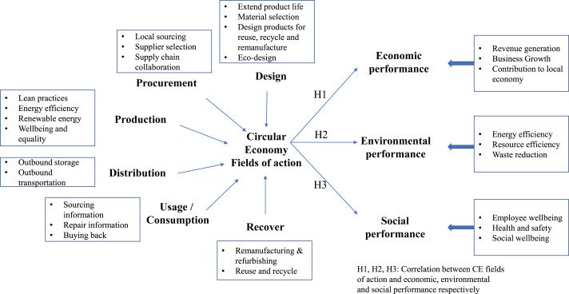
Circular Economy Fields of Action
Dig a Little Deeper!
Download : Download high-res image (591KB)
Download : Download full-size image
Source

Slide 32
Examples of CE Circular Economy and sustainability performance measures for SMEs
Circular Economy
Design Actions | Design aim is to extend product life. Material selection. Design products for reuse, recycle and remanufacture. Eco-design.
Procurement Actions | Applying environmental and social criteria in the selection of suppliers. Local sourcing to mitigate risks. Supply chain collaboration.
Production Actions | Lean practices. Energy efficiency. Use of renewable energy. Wellbeing and equality.
Distribution Actions | Outbound storage. Outbound transportation.
Usage/consumption Actions | Providing repair information. Providing sourcing information. Buying back used products from customers.
Reverse Logistics Actions | Remanufacturing and refurbishing. Reuse and recycle.
Sustainability Performance
Economic performance | Increased revenue. Business growth. Contribution to the local economy.
Environmental performance | Energy efficiency. Resource efficiency. Waste reduction
Social performance | Employee wellbeing. Health and safety. Social wellbeing.

Slide 33
Reduce Reuse Recycle for SMEs
Small and medium-sized businesses (SMBs) can make some of the largest environmental contributions when they choose to adopt the motto “reduce, reuse, recycle.”
This is because they are inherently larger-scale and wider-reaching, leading to far greater impact than an individual or household.
They have control over their supply chains and can make small choices that have far-reaching effects on the environment. They can act quickly by;
Reducing the total amount of waste they create
Reusing as much as possible
Recycling anything and everything

Slide 34
How Businesses Can “Reuse”?
The overall goal of reuse is to delay a product’s end-of-life or eventual disposal. “Reuse” in the business world can mean many things.
For example, you can commit to purchasing second-hand furniture or donating old items instead of disposing of them.
You could also implement policies for employees to reuse certain materials multiple times before disposal, like cardboard boxes, bags, office supplies, and more.

Slide 35
How SMEs Can Manage Waste
SMEs produce different types of waste depending on their business. Restaurants will have mainly food waste and manufacturers mainly cardboard, wood, and metals. This doesn’t mean all waste can just be tossed in the recycling bin. Many products produced by businesses must be separated by waste stream and recycled accordingly. Some examples of waste streams that require special disposal methods include:
Commercial recycling Including cardboard, metal, glass, paper, plastics, and more;
Organics recycling Including food waste, wood, oil and grease, and more;
Construction and demolition (C&D) waste Including wood, concrete, drywall, cardboard, metal, plastics, and more;
Electronic waste (e-waste) Including computers, televisions, phones, printers…
Regulated waste Including bleach, cleaning chemicals, flammables, corrosives…
Universal waste Including batteries, pesticides, mercury devices, cosmetics, car parts, and more.
Underpin with a comprehensive corporate recycling program to ensure valuable, otherwise recyclable materials are not ending up in landfills (and your bottom line stays protected.)

Slide 36
How Companies can Join the Circular Economy
Reduce the use of hazardous materials
Reduce energy and water usage
Reduce waste generation
Increase investment in waste management infrastructure
Increase segregation and recycling of waste Increase education and training for staff in sustainable business practices
Increase promotion of sustainable business practices to suppliers
Creation of an internal 'Green Team’
Increase use of local supply chains where possible
Increase local recruitment of staff where possible
Increase consumption of services rather than goods
Increase organisation-wide focus on improvements related to the circular economy
Increased partnerships with social enterprises (e.g. food cloud, rehab enterprises, etc.)

Slide 37
How Manufacturing Companies can Join the Circular Economy
Develop new products through innovation and R&D investment
Increase investment in the innovative design of goods and services
Invest in innovative delivery of services
Improve recyclability of company products
Extend the lifetime of products by making them easier to repair and reuse
Improve ease of dismantling products at end of life to ensure reuse of parts
Increase re-use of secondary raw materials in the production process
Reduce use of critical raw materials
Sustainably source of raw materials
Reduce use of single-use packaging materials
Increase the use of re-usable packaging materials during transit

Slide 38
How Services and Distribution Companies can Join the Circular Economy
Recommended Reading on Waste Reduction
Managing and Reducing Wastes: A Guide for Commercial Businesses
Benefits of Addressing Waste
How to Track Waste
Improve Your Practices
Resources
Develop new products through innovation and R&D investment
Increase investment in the innovative design of goods and services
Invest in innovative delivery of services
Innovation in existing products to support the development of circular economy
Localisation of the supply chain
Reduce the use of single-use packaging materials
Increase use of re-usable packaging materials during transit

Slide 39
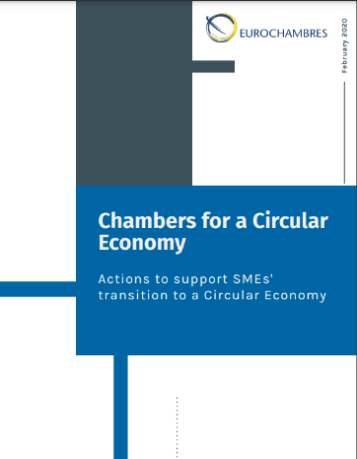
Need Help?
Work with an expert or support organisation to develop your circular economy capacity
Recruit skilled CE staff
Get expert advice before you invest in technology/equipment
Find suitable training Availability of information
Begin and instil management commitment Source and implement available funding
See CSR READY Case Studies where supports in each of your countries is provided)
https://www.eurochambres.eu/wp-content/uploads/2020/06/Chambers_for_a_Circular_Economy_2020-2020-00016-01.pdf

Slide 40
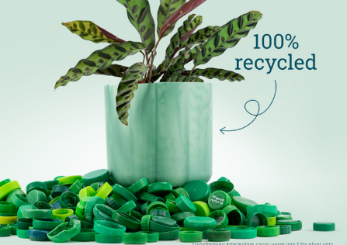
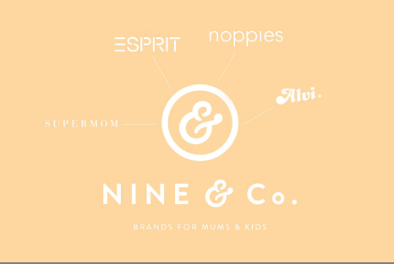
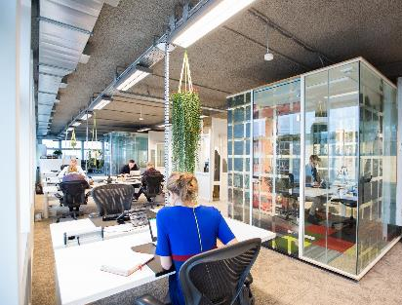
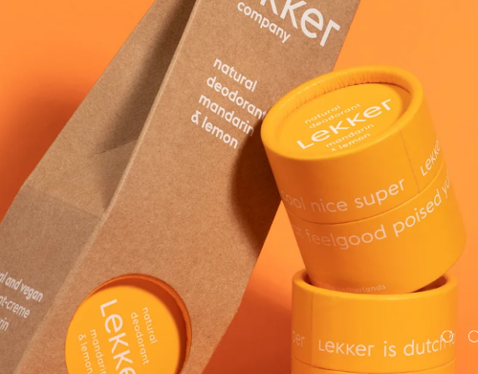
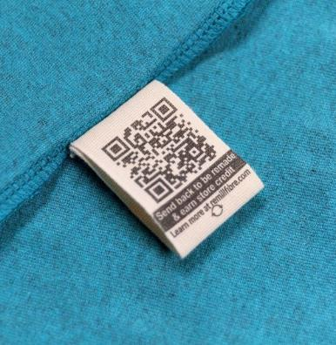
Better Future Factory, Netherlands designers and engineers help companies to create sustainable plastic products. They create and sell designer goods such as furniture made from recycled waste e.g., they make textiles from pineapple waste.
NINE & Co., Denmark sell and manufacture circular economy baby clothes and products. They make their customers aware of the impact of their choices, providing transparency on the impact of their products, and hoping to inspire conscious consumption.
Copper8’s, Netherlands build a circular economy in the manufacturing and construction industry. Their entire business is focused on accelerating the transition to the circular economy through active promotion, research and consultancy.
Circular Economy European SME Examples (also see CSR READY Case Studies)
Culinary Food Group, Ireland is an Agri-Food business in Ireland and a leader in Circular Economy Practice in waste reduction. Barry was a founding member of CIRCULEIRE which is The National Platform for the promotion of The Circular Economy.
The Lekker Company’s, Netherlands brand and cosmetic products are built around being natural and vegan, minimising harm to people and the planet. The Lekker Foundation donates 1% of the revenue to a charity or non-profit that benefits the planet and people.
Rapanui, Ireland, Ireland makes circular organic clothing designed from the start to be sent back to them when it is worn out. Make new products with the material they recover.

Slide 41
Impactful Sustainability Practices and Resources For Businesses
Corporate sustainability goes beyond “reduce, reuse, recycle.” Here are some key sustainability practices in business you can adopt in the journey towards corporate social sustainability
EU companies should have the free use and access to web-based guidance and online training relative to their countries that offer capacity building through regulatory consistent advice and expert guidance example or Ireland is the Green Start Program, Green Plus and Green Transform and E-Learning from the Health and Safety Authority (HSA) provides a range of e-learning programmes
In Ireland, there are also online assessment tools e.g., EPA's Carbon Footprint Calculator, ESM Webtool, EPA Tool for Resource Efficiency and BeSmart.ie which is a free online Safety Management and Risk Assessment Tool from the Health and Safety Authority.

Slide 42
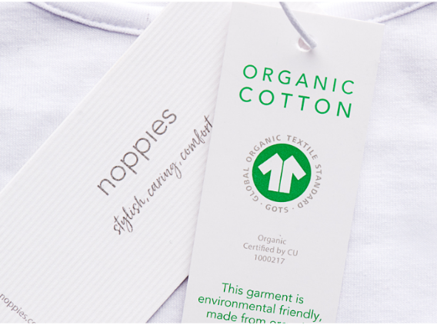
Nine & Co Rethink, Redesign, Redevelop, Review Step by Step
NINE & Co. looked at the entire lifespan of their products to discover where and how they can apply circular principles. The circularity strategy at NINE & Co. is focused around three phases 1) the design of products, 2) the use phase and 3) the distribution of products.
Case Study
Nine&Co Children’s Clothing
In the design phase, NINE & Co. focused on using sustainable and circular materials, continuously growing the share of these materials and using more low-impact production processes. NINE & Co. plan to do research on how they can further enhance the circularity of their designs, aiming for extending the lifetime of products and keeping fibres in the use-loop.
(also see CSR Ready Case Studies)

Slide 43
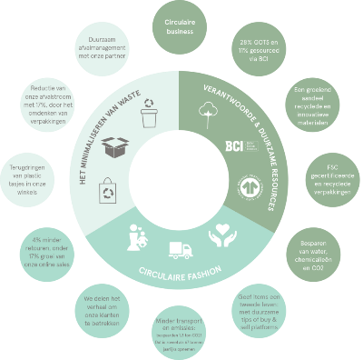
Nine & Co Rethink, Redesign, Redevelop, Review Step by Step
NINE & Co. have exclusively been using certified cardboard (FSC quality mark) and 100% recycled paper for sending parcels from the central NINE & Co warehouse since 2014. They continue the CE improvement process.
Circular Economy Model
In the use phase NINE & Co. involve consumers and encourages them to make more sustainable choices to reduce their impacts. This includes simple but effective measures such as improved size charts and washing instructions.
In the distribution phase, the packaging is one of their main focus paints. In 2019 they started using 100% FSC-certified carton board in their packaging. In 2020 they started using almost 30% recycled cartons. In 2021 they started using 100% recycled polybags. They recognise that the transportation of their products is a key area for future improvement in their value chain.

Slide 44
Implementing Circular Economy Models
This section explains CE Implementation using 8 steps on how to implement circular economy models so SMEs can consume less, consume better and create systemic change.
Section 3

Slide 45
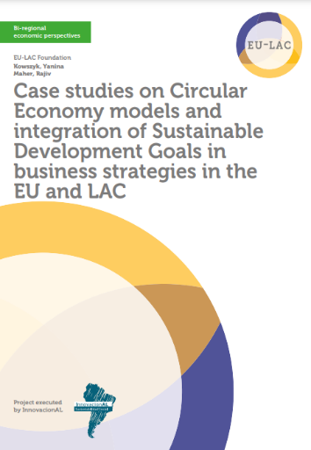
Implementing Circular Economy Models
This guide is a great resource demonstrating great case studies and resources on implementing Circular Economy (CE) models. One size does not fit all the concept of CE is very complex and detailed, as such requires holistic and systemic thinking by companies in order to be implemented. The next section will touch on the eight steps involved in implementing CE. For further technical implementation of CE please refer to some of the tools referenced at the end of this guide.
https://eulacfoundation.org/en/system/files/case_studies_circular_economy_eu_lac.pdf

Slide 46
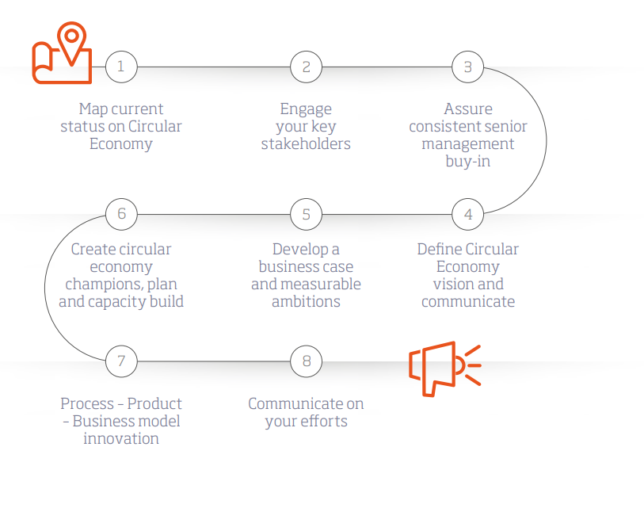
Implementing Circular Economy Thinking
Map your current status on Circular Economy
Engage key stakeholders
Assure consistent senior management buy-in
Create circular economy champions, plan and capacity build
Develop a business case and measurable ambitions
Define circular economy vision and communicate
Process – Product – Business model innovation
Communicate your CE efforts

Slide 47
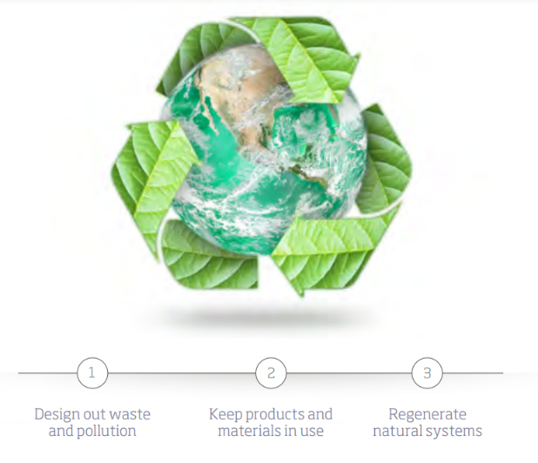
Steps 1- 8 Implementing Circular Economy Thinking
Step 1. Map Your Current Status on Circular Economy
Review all your current practices and activities to map what you are already doing that could be considered as ‘circular thinking’. Consider all business units and include operations as well as products and services in your review.

Slide 48
Step 2. Engage Key Stakeholders
Stakeholders such as customers, NGOs and communities play an important and influential role in driving the CE agenda. One way to engage with these actors is via focus groups. When engaging with employees and stakeholders, it is important to encourage them to think outside the box, as CE is about eliminating the whole concept of waste. Organisations should identify good, appropriate and relevant expert organisations (consultancies or NGOs) with whom they can partner from the outset throughout the transition to a CE business model. With regards to internal stakeholders and employees, one way of encouraging engagement with them is to ask them to reflect on where your business currently experiences high costs, such as a large waste stream or one that is hard to recycle. Other areas of poor performance like high levels of product returns, or complaints about product durability, which can get negative media coverage, should also be explored.

Slide 49
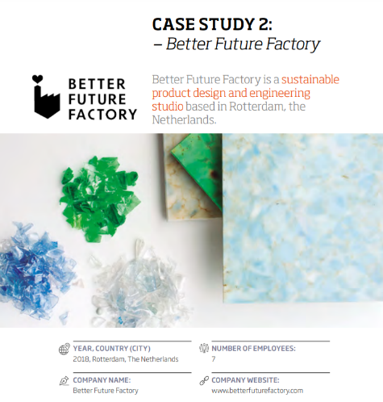
Step 3. Assure Consistent Senior Management Buy-in
The World Business Council for Sustainable Development (WBCSD) and Boston Consulting Group’s (BCG) survey found corporate leadership was the most important factor in driving forward CE within corporations. Senior leadership’s commitment and steering on the subject is vital for the successful implementation. Without engaged senior management and leadership, circular economy thinking will not advance within organisations. It is therefore important that senior management and leaders are made well aware of the concepts of CE and its potential benefits and impacts to the business.
See Case Study Better Futures Factory, Netherlands how they Implemented their CE Sustainable Product Design. Page 46

Slide 50
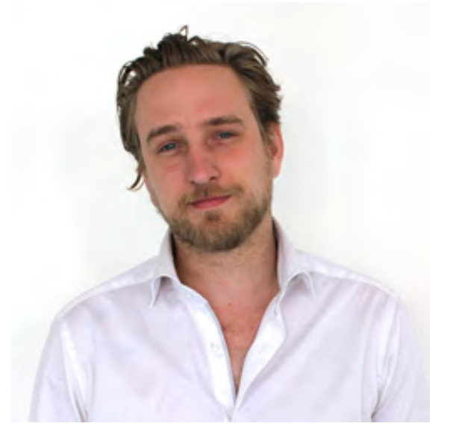
Better Futures Factory
Doing things sustainably, circular economy that’s what we try to incorporate in everything we do
Jonas Martens

Slide 51
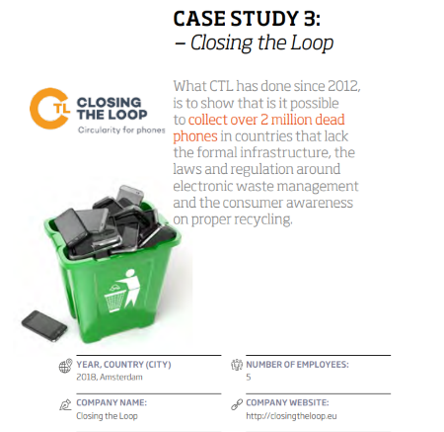
Step 4. Define Circular Economy Vision and Communicate
Management should clearly define from the beginning what the company understands as “circular economy” in terms of strategy and operations. This will make it easier for management to communicate the concept of CE to employees and stakeholders. The definition is unique for every company and its specific context. It is important to bear in mind that no business alone can solve all the challenges it faces to become more circular. Many issues can only be solved by collaborating with different businesses and sectors, throughout value chains and even with national and local governments.
See Case Study Closing the Loop, Amsterdam how they Implemented CE services based on mobile phone recycling. Page 58

Slide 52
Step 5. Develop a Business Case and Measurable Ambitions
The WBCSD and BCG found that 81% of companies surveyed with CE strategies also had a clear business case. In order to motivate and engage employees on the CE, management should quantify their ambitions and set goals to move forward. Ambitious, measurable goals drive action, create accountability and emphasise the need for change. Organisations should seek to disrupt themselves instead of waiting for external actors. The best way to demonstrate a business case is by having Key Performance Indicators (KPIs) in place to measure progress. Regular reporting, both internally and externally, helps maintain accountability.
See Case Study Donar, Solvenia how they Implemented CE design production of industrial material. Page 66

Slide 53
Step 6. Create Circular Economy Champions, Plan and Capacity Build
Bioregional4 recommends that organisations convene a working group that cuts across operations and products/services, including key influencers who can champion your approach to CE. This group of champions could review what the organisation has already done in terms of CE. They can help to create a shared understanding of what worked, what did not and why and what is currently planned. The group could also start to plan an organisation-wide vision for a new CE version of the business. They can create roadmaps, in order to fully embed CE thinking within the business. The 1-3-year plan would focus on smaller incremental change, piloting relevant ideas that can be scaled up in the future.

Slide 54
Step 7. Process – Product – Business Model Innovation
The WBCSD and BCG argue that it makes more sense for businesses to begin with the least disruptive forms of change on the journey towards CE. This means companies should start with changes to the business processes; once these positive gains have been established it will be easier to transition to a circular way by disrupting the products and finally the business model

Slide 55
Step 8. Communicate on your Efforts
Disseminating information about circular initiatives can attract new demand, strengthen existing relationships and please investors. Since circular initiatives can translate into greater profits, promoting a company’s circular projects is not to be underestimated. Moreover, investors increasingly screen their investment options with sustainability criteria and will divest from companies they consider too risky in terms of sustainability. In short, if you’re “doing good”, then you should communicate your efforts.

Slide 56
Useful — Further Resources
Bioregional https://www.bioregional.com/cracking-circular-challenge-get-started-circulareconomy/
BSI Circular Economy standard https://www.bsigroup.com/en-GB/standards/benefits-of-using-standards/becoming-more-sustainable-with-standards/BS8001-Circular-Economy/
Ellen MacArthur Foundation https://www.ellenmacarthurfoundation.org
EU strategy on circular economy https://ec.europa.eu/commission/priorities/jobs-growth-and-investment/towardscircular-economy_en
EU circular economy action plan http://ec.europa.eu/environment/circular-economy/index_en.htm
WBCSD https://www.wbcsd.org/Programs/Energy-Circular-Economy and https://www.wbcsd.org/Clusters/Circular-Economy-Factor10/Resources/The-newbig-circle

Slide 57
Well Done!
You Have Completed CSR READY!
https://www.csrready.eu/
Facebook

