Slide 1
Module 8
CSR Adaptation to Digital Tools & Technologies
"The European Commission support for the production of this publication does not constitute an endorsement of the contents which reflects the views only of the authors, and the Commission cannot be held responsible for any use which may be made of the information contained therein 2020-1-DE02-KA202-007503’
This resource is licensed under CC BY 4.0

Slide 3
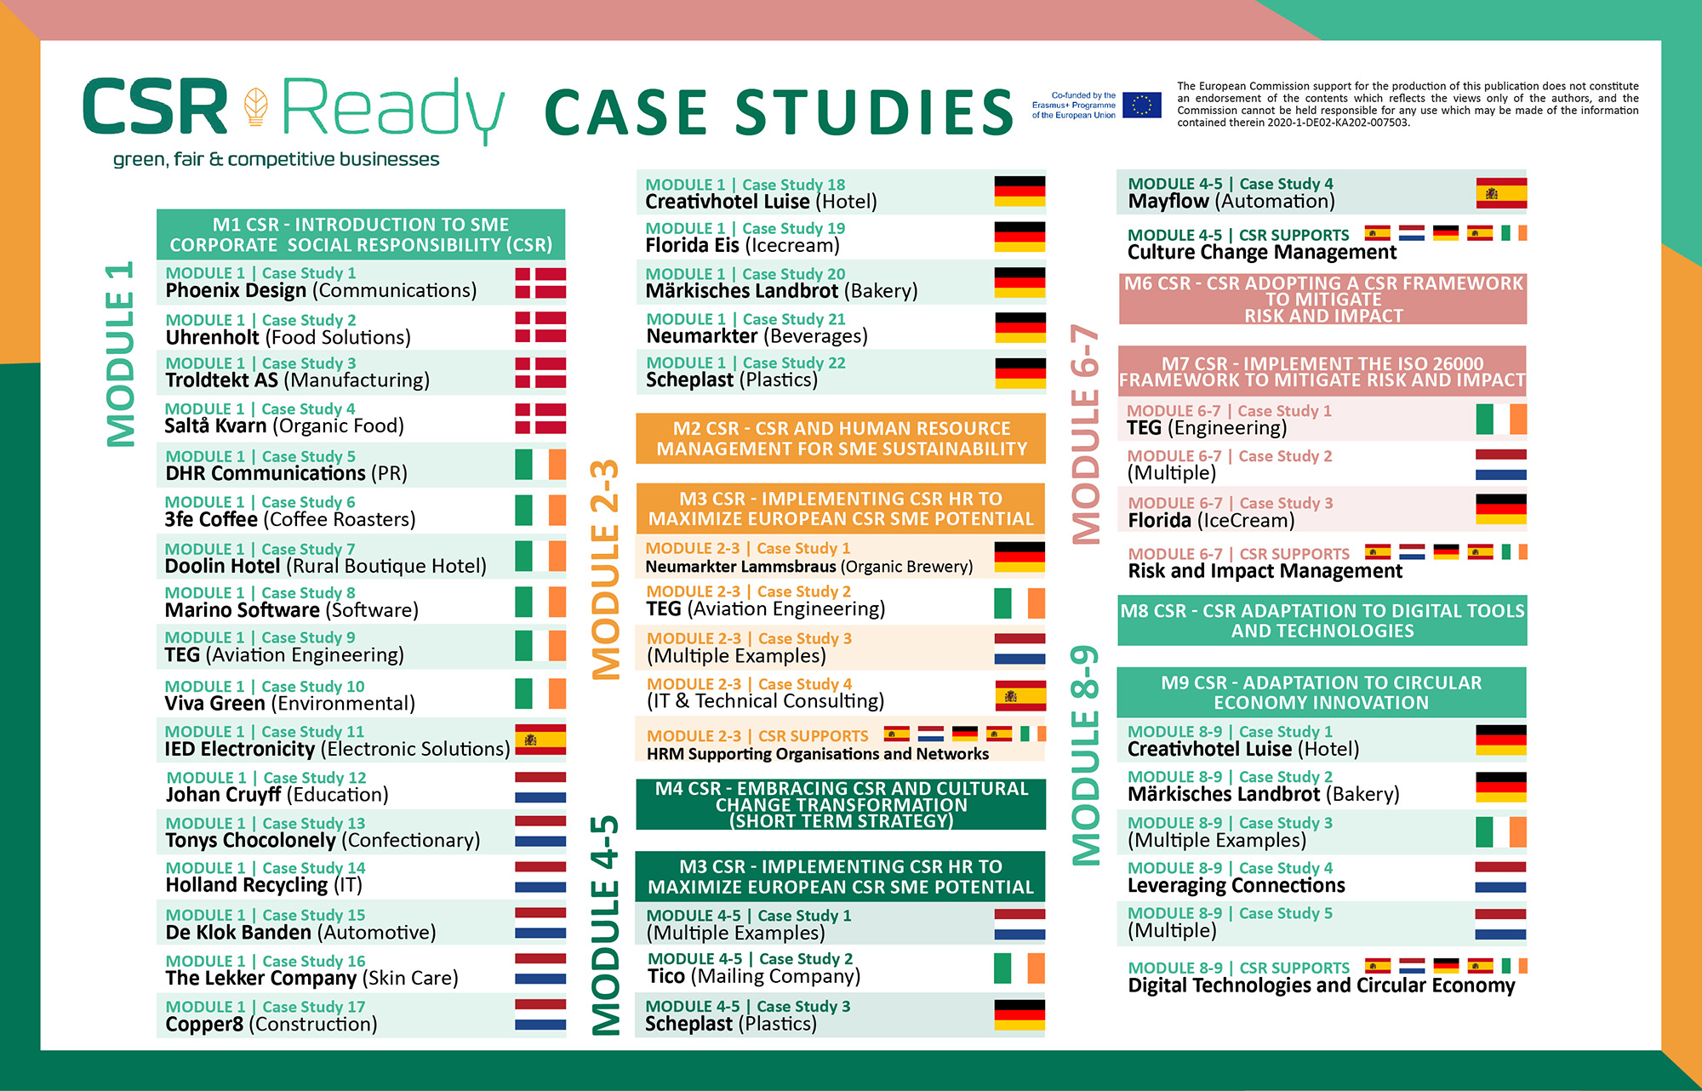

Slide 4
Overview of Module 8
Contents
This module explains how businesses can adapt digital technology and tools, sustainability and Circular Economy innovations for CSR. It demonstrates how such approaches are a good way of doing business that benefits businesses, the economy, the marketplace, people, and the planet. Everyone wins. Businesses will learn how they can move forward in a more sustainable better way by implementing accessible and affordable short-term measures that can be adapted quickly providing significant benefits and opportunities.
1
CSR Adaptation to Digital Technologies is the Right Move for SMEs
2
Examples of CSR Adaptation to Technology
3
12 Cost Effectively Ways SMEs can Adopt CSR Technologies Affordably and Quickly

Slide 5
Learning Outcomes
Understand the beneficial linkages between digital technologies and CSR with SME operations and how it can simultaneously benefit society, economies and the environment
Learn how the different types and ways digital technologies can be implemented to benefit your company
Access 12 quick affordable and accessible digital tools and technologies that are game changers and win-win measures to achieve CSR ethos and SME business operations

Slide 6
Why CSR Adaptation to Digital Technologies is the Right Move for SMEs
CSR adaption to digital tools and technologies is the right move for SMEs into sustainability. Easing staff workloads, saving resources, generating revenue and maximising operational efficiencies that simultaneously benefit socially, economically, and commercially.
Section 1

Slide 7
Digital Technology Adds Business Value and Supports CSR Practices
New technologies have greatly impacted the social, economic and corporate spheres in recent years. This has caused a drastic shift in the business landscape, spurring many companies to integrate digital transformation strategies into their short-term goals.
Corporate Social Responsibility is one area in which digitalisation has helped companies to advance. Implementing new technologies adds business value, supports good CSR practices, and furthers a more environmentally friendly vision.

Slide 8
Why SMEs Need Digital Technologies
New emerging technologies and their rapid expansion into today’s society, and our daily lives mean companies have had to adapt to the current scenario to meet needs and expectations— especially after the challenges presented by the pandemic. As a result, businesses are now looking to investigate how digital technologies can benefit their business by making them more efficient and productive and in some instances replacing traditional processes that aren’t working anymore with digital operations.
It is not an easy task for companies, but today’s competitive market requires it. Businesses require digital technologies so they can offer up-to-date, tailored solutions that meet clients’ and customer needs to retain their customer base and stay relevant. This Module covers how this can be done relative to the mega topic of CSR.

Slide 9
What is Digital Transformation
Digital transformation is a course of action in which digital technology is applied to various business processes in an effort to improve efficiency, deliver value, improve company culture and streamline operations.
“Digital transformation is about the digital change process based on new value propositions.”
It is understood that we “digitize information, digitalize processes and roles for extended platform-based business operations, and digitally transform the business by promoting a digital strategy, customer-centric and value-oriented digital business models, and architecture-driven digital change.”

Slide 10
Intersection of CSR and Technology
The digital transformation era is not new it has been a topic for 15, to 20 years. Now you have Spotify or Netflix as your favourite streaming services. ‘You have e-commerce, so companies have to think about selling online.’ However, it is also said that some companies are still behind and could lose their edge.
“A lot of companies are still trying to digest the first wave, trying to move part of their sales to e-commerce while many companies are already moving to the second wave of digital transformation’ (source)

Slide 11
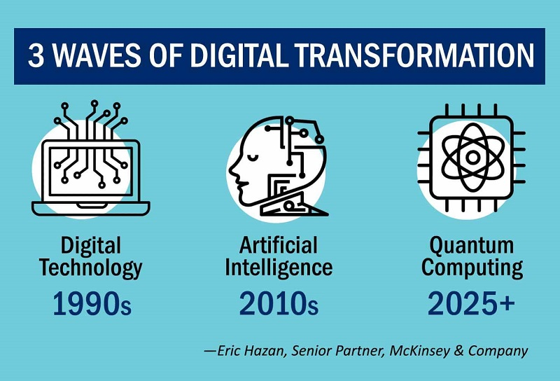
Source https://www.aesc.org/insights/magazine/article/tsr-intersection-technology-corporate-social-responsibility

Slide 12
Digital Tech Adoption is Part of Most Sectors
Usina says, “Financial services was probably the next sector on that spectrum. I think healthcare is following that just because it was more complex from a regulatory and a complexity perspective. And then the industrial environment is late to the topic of digital transformation, and many are only just understanding what digital means for them today.”

Slide 13
Technological Social Responsibility (TSR) and Digital Tech Adoption
Digital Tech Adoption is the process of learning how to use technology as it evolves so you can take advantage of its full potential. It extends well beyond information, retail and entertainment. It covers engineering, farming, finance, and health.
As it evolves from the next stage industrial revolution the disruption is relentless, companies should rethink and look at the opportunities opportunity in CSR so they can balance the benefits and the pain of social and environmental impacts now and in the future.
Managing Director for Sheffield Haworth. says, “The topic of corporate social responsibility is not new, but the part technology plays, and the impact delivered is increasing and beginning to be understood as an advantage.”

Slide 14
Eric Hazan, Senior Partner at McKinsey & Company, puts TSR (Technical Social Responsibility) in the frame of Technology Should be At the Heart of a Company’s Strategy
“If you are working in the manufacturing industry, you know that you will be continuing to automate part of your supply chain, that’s thanks to technology. You can decide that you want to focus on only cost reduction, or you can decide that you will retrain people who lack the skills you now need because they know the company, they have accumulated experience, and you can reallocate them to other tasks that involve technology. We call these elements ‘technological social responsibility,’ because we think that technology should be at the heart of a company’s strategy, including the impact it has on all stakeholders.”

Slide 15
How Businesses Can Improve Their CSR Through Digital Transformation

Slide 16
Manage Environmental Impact
Digital business transformation measures can help companies become more eco-friendly on both a small and large scale.
One way to take the first step is by going paperless. Administrative digitalisation solutions like digital signature and electronic invoicing enable paperless operations. This small change has big repercussions: your company can contribute to a reduction in CO2 emissions, conserve water and save trees that would otherwise be used in the manufacture of paper. Corporate social responsibility and sustainability go hand in hand. (Source) Digital technologies can make you more efficient, become a market leader, save you massive amounts of money and make you more money. See Florida Eis Case Study in the next slide.

Slide 17
FREE Irish Digital Environmental Tools
There are many web-based guidance and online training that offers CSR environmental capacity building through regulatory advice and expert guidance example Green Start Program, Green Plus and Green Transform and E-Learning from the Health and Safety Authority (HSA) provide a range of e-learning programmes
Online assessment tools e.g., EPA's Carbon Footprint Calculator, ESM Webtool, EPA Tool for Resource Efficiency and BeSmart.ie which is a free online Safety Management and Risk Assessment Tool from the Health and Safety Authority.

Slide 18
1. Rise To The Occasion Of Stakeholder Expectations And Needs
The well-being of the planet and its inhabitants is at stake, as well as the reputation of your company.
Companies need to adapt business procedures to address societal and environmental concerns, and offer strategies that boast a more socially responsible vision to stakeholders and the public. Customer demand to purchase from socially and environmentally conscious companies continues to grow. The socially conscious consumer makes mindful purchase decisions, deliberately buying ethical and environmentally friendly products. They vote for their values lies with their wallet. In fact, 45% said they are willing to pay more for sustainable products. Digitalisation solutions can help businesses meet customer and stakeholder expectations and move their company towards a more socially conscious future. It will also enable businesses to align with the philosophies of a more aware, technologically-oriented talent pool, automating their workflows and facilitating the onboarding process for new hires.

Slide 19
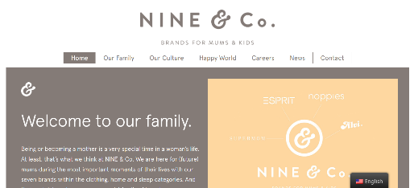
NINE & Co. Children’s Clothing
NINE & Co created an entire document outlining their CSR Strategy and Framework, as well as action plans to reach their goals.
Reasons for Adopting New Technology
Realising supply chain responsibility
Investing in the health & safety of mothers and babies
Growing NINE & Co. as a circular business
Case Study
NINE & Co, Children’s Clothing
Click to See their Full CSR Journey & Case Study

Slide 20
2. Comply With Current Legislation
Best practices in corporate social responsibility increasingly coincide with legal compliance on both the national and international level.
Regulation of the European Parliament and of the Council of 23 July 2014 on electronic identification and trust services for electronic transactions in the internal market is commonly known as eIDAS (electronic IDentification, Authentication and trust Services).
Digital solutions assist with many areas of business including regulation and legal needs e.g., signing documents electronically, as well as managing e-invoicing and payments which must comply with European digital regulations. A digital signature needs to be legally valid under European Regulation (EU) No 910/2014 on electronic identification and trust services for electronic transactions (eIDAS regulation), as well as other international legislation. Another example is sending and receiving e-invoices through electronic signatures must comply with current regulations on electronic invoicing, such as PEPPOL and the European Standard EN 16931.

Slide 21
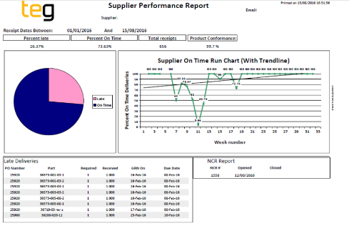
TEG Engineering, Ireland
Case Study
TEG, Ireland Engineering
TEG built a supply chain stability and sustainability by monitoring supplier performance and using digital document tracking, document signatures, digital reporting and supplier performance reviews including on-time Delivery & Quality through Non-Conformance Reports (NCRs).
“A two-way supplier engagement process has seen a big increase in on-time deliveries to us and subsequently for us onto our customers“
TEG has also developed an Energy Management System (EnMS) with a corresponding cloud-based tool.
https://www.bitc.ie/sme-case-studies/teg-building-supply-chain-stability-and-sustainability-by-monitoring-supplier-performance/
Click to See their Full CSR Journey & Case Study

Slide 22
TEG Engineering, Ireland
‘I suppose a simple lesson in this is that if we continued as we were our suppliers would have to, but with clear and concise recording and reporting of their performance to them, they want to improve this and satisfy our expectations as we do our customers’.
By doing this our suppliers now have:
A much clearer understanding of our expectations.
How other suppliers are performing against them.
Having our approved supplier list tracked and monitored, as a direct result of these activities we have seen:
A big increase in on-time deliveries to us.
A subsequent increase in on-time deliveries onto our customers.
A significant improvement in the incoming quality of parts.

Slide 23
3. Combat Fraud
Companies that promote a business strategy based on corporate social responsibility best practices should be coherent and ethical in their approach, which includes combating fraud.
The pillars of CSR reflect a strong belief in ethical values, which aligns with a commitment to preventing and detecting fraud. Ethical issues include conflicts of interest, regulatory workflows, ethical suppliers, due diligence, bribes, conflicts of loyalty, and issues of honesty and integrity. For example, security measures, reporting, authentication, data validation, document verification, and biometric verification. All these can be prevented or detected using digital solutions to help companies avoid problems traditionally associated with signing on paper, document falsification etc. For example; managing invoices electronically enables greater control and facilitates above-board procedures, preventing companies and vendors from engaging in unethical tax or CSR practices.

Slide 24
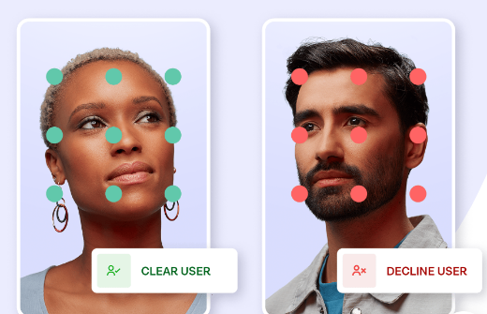
Case Study
Onfido, Compliance and Fraud Software
Onfido is a European technology company that helps businesses with global and European compliance, and fraud prevention e.g., verifying people's identities using a photo-based identity document, a selfie and artificial intelligence algorithms. Protect your brand and customers. Stop fraud at the door with a combination of verifications and passive signals. Industries they work with include financial services, gaming, health care, marketplaces and communities, retail, e-commerce, telecommunications and transport.
https://onfido.com/use-cases/?utm_source=google&utm_medium=cpc&utm_campaign=fraudprevention

Slide 25
Cyber Security
Cybersecurity is becoming increasingly important in the modern era, with the threats of cyber-attacks rising. Data breaches are becoming increasingly common, and more expensive. According to CSO Online,“…just under 30% of organizations are likely to suffer at least one breach over the next 24 months”. One of the most notable mistakes that many companies make in regard to cybersecurity is that they act reactively as opposed to proactively.

Slide 26
4. Seizing CSR Opportunities for Positive Change
Businesses in particular must play their part to seize opportunities and do their part in solving world problems such as hunger and climate change. Technologies can assist this effort by streamlining, connecting and managing people, resources, and activities.
Take your corporate giving to the next level by creating a CSR Synergy or Exchange Network by creating or joining a digital network, group or system so that you can work together, and share knowledge and resources to assist those most in need. Share the costs, volunteers, marketing efforts, and impact benefits. Digital tools boost engagement and purpose for all stakeholders including the community and employees – anyone within digital reach. It spurs engagement, participation, sharing, donations, positive conversations and contributions. See next how Food Cloud works with companies to share CSR engagement and synergies.

Slide 27
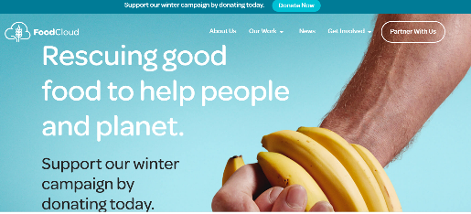
Case Study
Food Cloud, Food Distribution Network
Food Cloud, Ireland
Food Cloud connects businesses that have surplus food with Charities and Community Groups that need it. Through their technology, they can share their technology and information with food banks through their Retail Technology Solutions, Hub of Charities and Communities and Cloud Technology Platform. Food Cloud use real-time data and automated data collection processes to allow for online reporting, and sustainability dashboards.
https://food.cloud/

Slide 28
5. Forming Positive Connections, Awareness, Engagement and Experiences
CSR digital communication approaches are conducive to the digital age. CSR digital communication platforms, channels and formats have an important role in interaction, dialogue and experience sharing.
Further Reading
The Future of Digital Marketing
CSR digital communication, interaction and connections further increase sales and customer loyalty and influences stakeholders’ opinions and behaviour. CSR software can accurately measure the effectiveness of CSR initiatives by tracking the impact of CSR programs. For communication, interactive communication technologies, websites and traditional channels in integrative ways for a smooth customer-focused experience development by incorporating all marketing communication elements, including public relations, social media, and advertising. Interactive AI technologies allow more interaction, dialogue and experience sharing amplifying messages that have a unified look, feel, and tone across channels. This stresses companies’ CSR contributions and solutions in a way that they are more engaging, awareness-building, pervasive, appealing and interactive.

Slide 29
Digital Technology Allows Companies to Communicate Positive PR, Transparency and Showcasing CSR Practices
The internet is increasingly becoming one of the main tools for the disclosure of CSR information (Harmoni 2012). Unlike traditional media (newspapers, magazines, billboards, television and radio), it allows the company to publicize detailed and up-to-date information.
Digital Communication Reinforces and Manages Reputation
Moreover, the information remains permanently available on the web, allowing the users to choose which subjects to access. It essentially minds your reputation, it answers and confirms customer and stakeholder doubts, queries and questions.

Slide 30
Technologies Allow Interaction with Stakeholders Themselves; Corporate websites provide an official perspective regarding CSR within the corporation for all its stakeholders, while interactive technologies are used not only to give more visibility to the companies’ social and environmental responsibility programs but also to allow maximum interaction with the stakeholders themselves.
Web technologies facilitate dialogue with stakeholders and furnish several benefits in terms of reputation enhancement and customer loyalty, the attraction and retention of competent employees, and the gathering of data, information and feedback on social trends (Kesavan, Bernacchi & Mascarenhas 2013).
In addition to corporate websites, companies are increasing the use of main social network platforms to involve stakeholders in more direct, immediate and interactive communication (Antal et al. 2002; Chaundri & Wang 2007; Kesavan, Bernacchi & Mascarenhas 2013)

Slide 31
6. Ensure Efficiencies, and Costs Savings So Companies Can Look after What Really Matters
Companies can not only position themselves as market leaders and offer their customers what they expect but reap savings in production and operational efficiencies. This allows time and resources to look after what really matters, our families, communities and environment.
By implementing digital technologies CSR companies can efficiency milestones including an average of 35% reduction in time spent on data capture, a 40% reduction in the time spent managing service delivery and a 40% to 75 % reduction in the time spent on reporting and analysis. There is also a reduction in manual effort spent gathering information and compiling reports freeing up valuable time for hard-working staff and allowing some time and resources to focus on what matters most to them looking after their communities, environment and families now and well into the future. The good news is CSR technology and tools facilitate this too or even better it can do both!!. In turn, with data and analysis, companies can assess and optimize the programs they deliver in order to maximize their impact and more efficiently demonstrate that impact to stakeholders and funders.

Slide 32
Case Study
Better Futures, Sustainable Plastic Engineering
Better Futures, Denmark produces and engineers' sustainable plastic products. They developed futureproof Packscan helps companies make their plastic packaging future-proof. The company has recycled 221 tonnes of plastic. Clients purchasing pumps from Neptuno have made annual energy consumption savings of up to 70% and 75% in the reduction of solid waste. This has also resulted in a decrease of 70% in CO2 emissions by Neptuno’s clients. For each Nico Less product that Donar produces, it recycles 70 plastic bottles. Closing the Loop has already recycled and saved 2 million phones from going to dumps in Africa (and potentially causing toxic waste).
https://hollandcircularhotspot.nl/case/better-future-factory-futureproof-packscan/

Slide 33
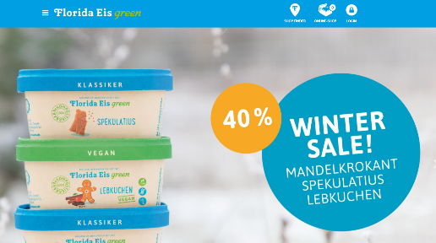
Florida Eis, Germany Invested in Innovative CO2 neutral production technologies resulting in massive cost savings using energy-saving technologies (e.g., eutectic cooling (storage cooling), electrically operated car and transport fleet, own photovoltaic and solar thermal systems, artificial permafrost made from recycled glass in the refrigeration hall, etc.)
Turnover quintupled since conversion to CO2-neutral production. Its sales increased five-fold in 2013.
Case Study
Florida Eis, Ice Cream Confectionary
Marketing benefits due to unique selling proposition. As a result, Florida Eis is Germany's only CO2-neutral ice cream producer – combines climate protection, handcraft and quality.
https://www.floridaeis.de/
Click to See their Full CSR Journey & Case Study

Slide 34
ActiTIME Time Tracking Software – Don’t Overestimate or Underestimate the Value of Time
Time-tracking software is versatile and often overlooked. It has more functions than assumed from time tracking, streamlining, project management, task assignments, business performance information, and more.
Without access to proper time tracking and management, it’s extremely difficult to allocate resources and time efficiently or properly. For example not knowing how long it takes to do a task, or how many people need to be involved in each stage, you are working with an extreme lack of information. This means that you will often over or underestimate the time needed to complete a task or the manpower. This can lead to a significant loss of productivity, in addition to costing your business much more money than need be.
Time tracking software, such as actiTIME, is a one-time tracking software for cost-effective productivity, performance, progress and tracking to bolster productivity in day-to-day aspects as well as long term and decrease business costs through a more efficient company as a whole.

Slide 35
7. Reduce Environmental Impact and Raw Material Consumption
CSR initiatives aim to reduce the negative impact of business on the environment. Example the case of the automotive industry, CSR in this field can be implemented by reducing pollution and raw material consumption, as well as through environmental compensation
Digital technology and tools can help businesses reduce environmental impact by creating products that can be recycled, reducing waste/water/energy/plastic consumption, optimising product life cycle, reducing packaging, and adopting sustainable transportation and distribution networks. In the fashion industry, a pair of jeans can take almost 10,000 litres of water to manufacture, Outland Denim uses innovative technology and laser equipment, to cut down on the amount of water needed for washing and bleaching by up to 65 per cent. Outland uses e-flow technology "It's brilliant in that it uses nanobubbles that mist the washing agents over the fabrics, versus submerging it in thousands of litres of water while reducing up to 95% of the water used."

Slide 36
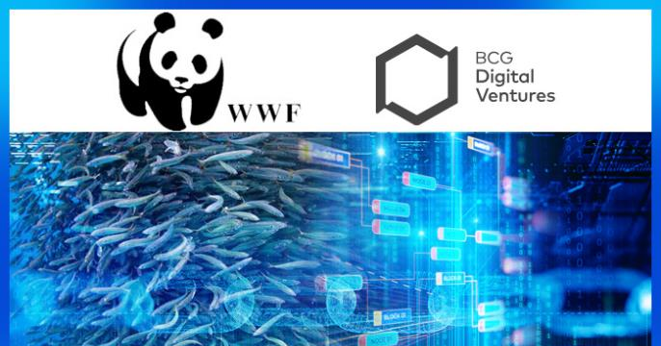
8. Connect to Other Local and Global CSR Leaders to Achieve SDG Sustainable Development Goals
Technology allows companies to work with other CSR organisations, individuals and networks e.g., researchers, designers, scientists, policymakers, etc They can donate, pool resources and share data and analytics to contribute to CSR, circular economy and sustainable development and support the SDGs. WWF works with the EU and private sector to deliver healthy marine ecosystems resilient fisheries, a balance between maritime activities and nature, and a sustainable blue economy. If you rely on the ocean or earths water system, you can use technology to support their cause. Austral Fisheries started using blockchain labelling as part of a pilot with the World Wildlife Fund (WWF) in 2018.

Slide 37
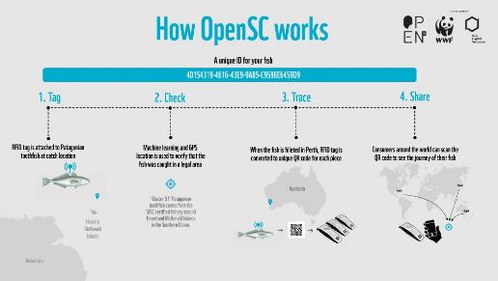
Pick up an Austral Fisheries toothfish loin in the supermarket, scan the barcode on the back of the packet, and you’ll be able to follow every step in the fish’s journey, from the deep ocean to shop shelf. Where and when the fish was snared; which vessel lugged it on board; the date it was unloaded in Mauritius; any Marine Stewardship Council or climate certifications. Even the name of the boat’s skipper. Today, the digital ledger covers its toothfish operations and a growing chunk of its shrimp catch. The ambition is to boost transparency and accountability and drive sustainable practices by harnessing consumer
choice.
Case Study
Austral Fisheries, Fishing Industry
https://www.australfisheries.com.au/sustainability/traceability
How OPENSC Works

Slide 38
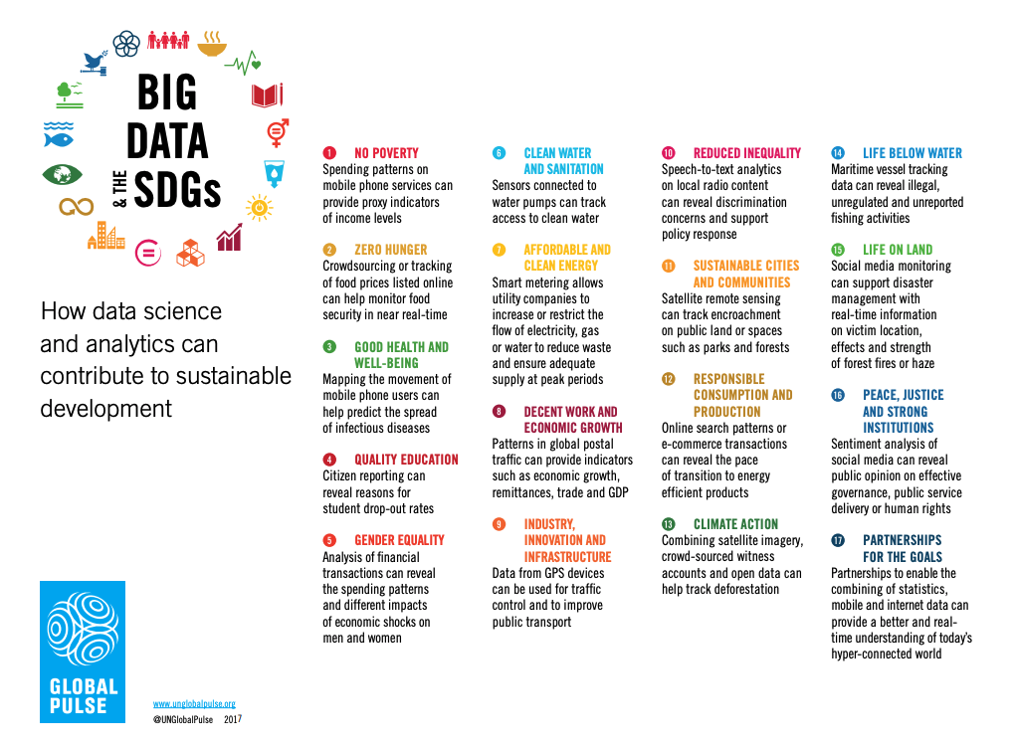
Data science and analytics have a key role to play in achieving these sustainable development goals. They provide critical information on natural resources that can be leveraged to enable sustainable development, particularly measuring impact, managing resources, tackling climate change, and more.
How Big Data Helps Address the UN SDGs

Slide 39
Examples of CSR Adaptation to Technology
For entrepreneurs understanding how they can use digital tools and technologies to make a positive impact on people and the planet can feel daunting. There are so many technologies, and so many issues to address. This section showcases different technologies and how they can be used in different ways by different sectors to advance positive change at relative ease and implementation.
Section 2

Slide 40
The previous section demonstrated the benefits of digital technologies and tools. You may think it is an expensive effort regarding investment and time however the costs always outweigh the benefits. From attracting and retaining customers who are looking for companies that share their values to saving by switching to energy-efficient ways. CSR programs can also create a sense of pride and loyalty among employees.
Ultimately, corporate social responsibility is about more than just doing good; it’s about creating a sustainable business model that benefits everyone involved. This section covers a a list of simple tools that any business leader — even those who just launched their business — can use to be a force for good.

Slide 41
noissue’s boxes and mailers are online eco-friendly, 100% compostable, and recyclable packaging and product providers. They deliver globally, just order online your customisable sustainable packaging. They are committed to sustainability for all their products, their simple online design platform, and low minimum order quantities. Get Inspired Here.
Environmental Packaging Tool
Make your packaging a form of branded advertising with a custom box or mailer. When you personalize exterior packaging, it means there’ll be no mistaking who the awesome package is from when your customer receives it! They do all types of packaging, bags, paper, boxes etc.
Custom noissue shipping/mailer boxes help you create the ultimate unboxing experience. They have partnered with other industry experts who can help you grow e.g., marketing, logistics and sustainability experts.! You can become a noissue reseller online to join the mission. Their partner programs allow you and others to link others to the cause.

Slide 42
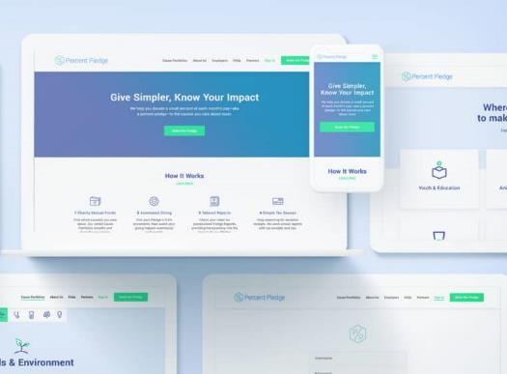
Percent Pledge Workplace Philanthropy. Percent Pledge creates social impact programs that are customizable and affordable for businesses of any size. Examples; helping with an easier way to manage employees donating to their communities, employee engagement, or organizing engaging volunteer events.
Social Employee, and Community Philanthropy, Volunteering Tool
Percent Pledge powers customized social impact programs, helping companies authentically improve employee engagement, employee retention, & employer brand. The easy-to-use platform & social impact experts offer a single source for donations, volunteering, charity vetting, & impact reports. Used by HR, People, Culture, and Social Impact leaders that want to make a difference in their company and in the world. It has a Workplace Giving Platform, Employee Giving Program, Impact Reporting, Employee Passion Assessment and more. Sample Impact Report . See how it compares to other similar platforms and further information.

Slide 43
Sustainable Digitalisation
Digital emissions account for around 2% of the global carbon footprint. This figure is expected to increase to 21% by 2030. Make sure that your website host is sustainable and CSR driven.
See Wix Sustainability and Corporate Social Responsibility Policy
See Wix Blog Why sustainable eCommerce as the future of good business and how to build an eco-friendly brand
See Wix Blog Sustainable Marketing
Environmental Digital Hosting Tools
If you’re on a hosted platform like Shopify, Wix or SquareSpace, check if they are sustainable and CSR driven. If you don’t know or can’t find an answer online email them and ask them for their sustainability policy. Digital SMEs provide articles and information on sustainable digitalisation. For more information on sustainable software and hardware, see here. Also consider sustainable search engines like Ecosia and Lilo, which plant trees and use their profits to fund social and environmental projects. For a 100% green web-hosting service, check out Krystal.

Slide 44
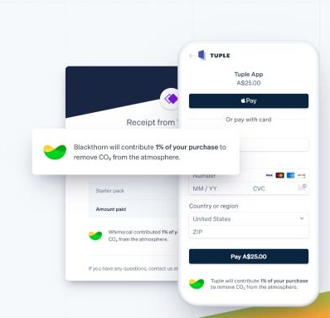
Stripe Climate to remove carbon as you grow your business.
Stripe Climate allows you to direct a fraction of your revenue to help scale emerging carbon removal technologies by funding technologies, organisations and research solutions needed to counteract climate change.
Environmental Payment Tool to Tackle Climate Change
Carbon removal is critical to combating the climate crisis and keeping our planet habitable for generations to come. Stripes innovative business model helps businesses tackle the issue. It is
a global company that allows you to remove carbon from the atmosphere. Stripe Climate, companies can direct a portion of their revenue to scale cutting-edge carbon removal technologies. Stripe Climate is part of Stripe, an American Irish company. Projects for example will receive a total of €2.75M from Stripe and 2K+ Stripe Climate users in 37 countries. Stripe climate commits €8m to six new carbon removal companies see examples.

Slide 45
Charity Charge Business MasterCard Provides financial tools and fundraising resources for non-profits to thrive. Every year over €16,000,000,000 in credit card rewards points go unused and expire. Doesn’t it seem like they could be put to good use by schools, organizations or charities?
Social Employee, and Community Donation Tool
The Charity Charge Business MasterCard helps empower startups to effortlessly give back every day. The card allows seamless corporate social responsibility by allowing your business to earn cash back that’s automatically donated to any non-profit of your company’s choice. There is no annual fee and the percentage that is automatically donated with every purchase is tax-deductible. You are also allowed unlimited employee cards, so you can get your employees involved as well.

Slide 46
Square App can help you go paperless and assist in business efficiency beyond payments, Square offers a suite of tools to get any job done, like point-of-sale, eCommerce, pickup and delivery, online scheduling, marketing, and more.
Environmental Paperless Payment Tool
Square helps sellers of all sizes start, run, and grow their businesses efficiently and paperless. Take payments any way you want. Whether online or in-person, get paid quickly and securely with a variety of hardware and software to process credit cards, Apple Pay, and Android Pay, including touch-free options. Connect your Square account with Xero to automatically sync your daily sales transactions and use Square as a payment service. Save time—no more manual data entry.

Slide 47
Sustain Analytics, Europe Measure the corporate CSR and ESG impact of activities and products. Morningstar Sustainalytics’ Corporate Impact Report calculates the social, environmental, and economic impact of a business, focusing on the material issues that are most relevant to its industry and region.
Marketplace
Stakeholder Engagement & Supply Chain Sustainability Tool
Link to Seminar ESG and CSR Digital Integration
Sustain Analytics assess the CSR impact of a company’s activities and products, including CSR programs, supply chain spending, and operations, enabling better insights to drive internal decision-making and improve reputation among peers, investors, and clients. Example; it looks at material engagement issues (MEIs) relevant to company type and location. How to avoid Greenwashing, how to instil stakeholder confidence by transparent data-driven reporting, how to assess your supply chain, communicate your CSR performance and provides a Sustainable Impact Framework with findings mapped to the SDGs.

Slide 48
Ibspartners Ireland specialise in implementing Digital Transformation, Sustainability ensuring continuous improvement when it comes to enterprise resource efficiency and environmental performance. They provide training, consultancy, programs, advice and guidance.
Environmental Resource Efficiency and Performance Tool
LBS Partners Green Start Program assists businesses to implement different CSR Management Systems based on the “Plan, Do, Check, Act” for continuous improvement so that businesses can better understand the carbon or environmental footprint of their products or services. They assist in developing a corporate sustainable strategy and aligning to national/international frameworks and best practices, such as Origin Green, UN Environmental SDGs, or CDP. Produce a Life Cycle Assessment to evaluate all environmental, social and economic impacts and benefits in company processes, so that they can work towards more sustainable products throughout their life cycle. Transition companies to Circular Economy thinking and business models relative to different industries.

Slide 49
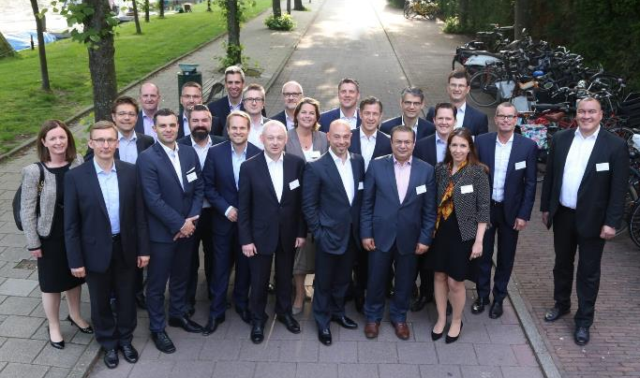
BearingPoint Transform Businesses for a Better Future for Everyone. They provide cutting edge digital products and services that deliver real competitive advantage. BearingPoint is thus strengthening its ability to support clients in all aspects of their sustainable, environmental and climate change development strategies.
Environmental Sustainable Supply Chain & Sourcing Tool
BearingPoint, with more than 1,000 employees in France and 4,300 in Europe, has had a dedicated practice in sustainable development since 2010. They provide multiple services that can assist SME CSR initiative such as assisting businesses to optimise their sustainability, strategy, digital responsibility and the calculation of carbon emissions with its emissions calculator solution. They use AI to achieve carbon neutrality, and provide transparency in supply chain and sourcing. They acquired I Care in 2022 to assist them in sustainability strategy development and environmental transition programs. Bearing Point Ireland.

Slide 50
Optimy is an online platform that streamlines and scales CSR initiatives. Manages all types of CSR projects such as grant making, sponsorships, volunteering, scholarships, and other aid initiatives from one platform.
Social Employee, and Community Inclusivity Tool
Based in Brussels Optimy allows businesses to amplify their social impact with an efficient and scalable platform. Their social impact strategy focuses on having a positive impact on customers, employees, communities and the environment through long-term projects. They believe that supporting all people and promoting inclusion across business and society makes the world a better place. They are committed to creating a diverse and inclusive culture that helps employees know they are valued, respected and empowered to bring their best ideas forward.

Slide 51
Vera is a simple way to offset your plastic footprint by funding jobs that prevent plastic from entering the ocean. Vera creates new jobs to collect ocean-bound plastic in impoverished countries that don't have waste-collecting systems. Collectors bring the plastic to Plastic Bank stores and exchange it for digital currency. What gets recycled is repurposed to make new products. What can't get recycled is sent to efficient, low-emission waste management facilities.
Environmental Divert Plastics From the Ocean Tool
Vera offers a simple way for businesses to offset their plastic footprint through a monthly subscription model. By becoming Vera-Certified, your business can help create new jobs for people who collect ocean-bound plastic. Businesses not only alleviate poverty, but also help divert plastic from the oceans. Everything is transacted through the blockchain, allowing you to track your impact. Vera’s collective already offsets more than 40,000 plastic bottles every month around the world. See Vera-Certified member Sofar Ocean, who build monitor and protect the ocean with its tools. It will offsets approx. 21,000 plastic items from entering the ocean every month.

Slide 52
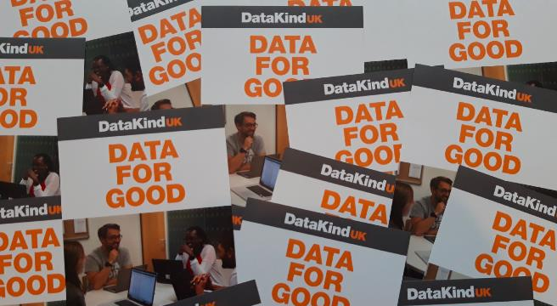
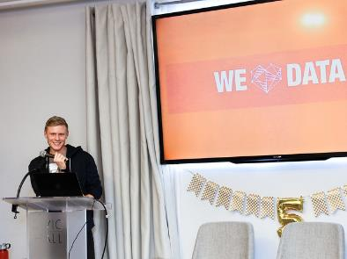
Datakind is a global non-profit charity that harnesses the power of data science + AI in the service of humanity. They leverage data science for the greater good. From helping Amnesty International develop an algorithm to predict human rights violations to using mobile data to help non-profits assess the impact of its programs, they work with small and large companies around the world.
Sample Digital Tool
Social
Data Tool that enables Social Changemakers and Scientists to Do Good
DataKind brings high-impact companies together with leading data scientists to use data science in the service of humanity. From one-hour events to year-long engagements, they have designed programs that enable data scientists and social changemakers to address tough humanitarian challenges together. Their work helps companies develop evidence-based decision-making, increase efficiency, and enhance their data literacy. It also introduces data scientists o the Data-for-Good movement and shows them how valuable their skill. They bring data science in all its forms to those who share their vision of a sustainable planet in which we all have access to our basic human needs.

Slide 53
12 Cost-Effective Ways SMEs can Adopt CSR Technologies Affordably and Quickly
This section covers simple, quick and effective ways SMEs can quickly adopt digital tools and technologies that can improve their CSR contribution and impact.
Section 3

Slide 54
1. Hybrid Working
Implement a digital hybrid-focused platform that allows employees to work remotely. This can help reduce environmental impact and enhance ethical production among others. It promotes environmentally friendly habits. Fewer people commuting reduces emissions, and working from home means fewer disposable items such as plates, cutlery and coffee cups. Make sure they are eco-friendly first. Read Best Sustainable Productivity Tools
2. Move Storage to Cloud
Moving your storage to the cloud eliminates your on-premises IT infrastructure costs as you will not be paying the energy costs to power the equipment. Cloud computing is 93% more energy-efficient than on-premises data centres.
Research by Berkeley Lab and Northwestern University, found that businesses could save between 60% and 85% in energy costs when they change over to cloud-based services.
3. Automation
Automation solutions can save your team endless hours and can add value to your company by reducing the amount of human labour needed for time-consuming, repetitive tasks, allowing your team to focus on higher-level tasks. Automation can also supply a simpler end-user experience, increasing efficiency and ROI and decreasing costs related to human error.

Slide 55
4. Renewable Energy
Most electricity is generated from fossil fuels which emit CO2 and pollute the environment.
Switch to renewable sources of energy such as solar. It is now affordable. They can help small businesses and companies to cut their carbon emissions as well as operational costs. For smaller businesses, the cost of using eco-friendly technologies like solar panels may be expensive at first, but companies will save a lot of money in the long run.
5. Go Paper Free
Another area where companies can go green is their use of paper. It is estimated that the cost of using paper is 30 times the purchasing cost. Employees can communicate to their employees, clients and customers through email.
Bills are being paid through digital channels. There are apps that allow businesses to schedule assignments, organize projects, and share documents and media with their employees without using paper.
6. Energy-efficient data centres
Computers require a lot of electricity and most power sources use fossil fuels.
Data centres that host big servers can contribute to millions of tons of pollution from the energy they consume. Therefore many businesses are transferring to energy-efficient data centres. Advanced servers that require less energy can minimize the carbon footprint. Cloud computing is another technology that reduces energy consumption and emissions and you don’t require physical infrastructure to work.

Slide 56
7. Go Online & Eco-Friendly Website
By going online companies can reduce the environmental impact of using concrete, electricity, water, and gas at that establishment. Online companies also reduce the number of people who have to drive to and from the office. Not all businesses but small businesses can completely go digital. Go E-commerce (e.g., Etsy or Shopify) or start an Eco-Friendly Website.
8. Electric Vehicles
EV is the future of the automobile industry. This is the reason why Tesla is so successful. Automobiles constitute well over 30% of the total carbon emissions. Conventional automobile relies heavily on fossil fuel. Therefore many big automobile companies are shifting to either electric vehicles or hybrid cars. However, right now the cost of an electric vehicle is very high and not everyone can afford it. But in coming years the cost is going to come down considerably. This shift from fossil fuels to electricity can have a positive impact on our environment.
9. Sustainable Software
The “Blue angel label” for software is sustainable by design certification scheme for sustainable software the “blue angel label for resource- and energy-efficient software”. Among the criteria to be certified are: Software producers can now certify their software in three areas energy efficiency, resource efficiency, and transparent interfaces.

Slide 57
10. Track Energy Consumption with IoT
Small businesses can use IoT or Internet of things technology to go green. A network of appliances are fitted with sensors that send information to a central database. Data is then analyzed and translated into information that people can use to know how well their appliance is working.
Restaurants can use this technology to make sure their refrigerators are maintaining the proper temperature so that they can reduce food wastage and save money.
11. Monitor Energy Usage
Get control of your energy use by installing smart meters is a cheap and quick way to track energy usage, reduce usage and save money. You can also use smart plugs as an alternative. They allow you to measure power use and to automate, by giving you data on the energy usage of different devices. You can also use them for scheduling, for example turning devices off overnight when they’re not being used, and when you’re out of the office. Install motion detector lights which automatically switch off when there’s no movement.
12. Sustainable CRM Tools
Choose a CRM tool that is environmentally friendly and sustainable to reduce your business’s carbon footprint. The internet accounts for roughly 3.7% of global greenhouse gas emissions. Of this 3.7%, 19% come from data centres. Cloud computing also uses massive amounts of electricity to power and cool the servers. This article, goes through how CRM tools affect the environment, and gives a verdict on the CRM software you should be using if you want to reduce your business’s carbon footprint. (Read)

Slide 59
Well Done!
You Have Completed Module 8
Next is Module 9
Adaptation to Circular Economy Innovation
https://www.csrready.eu/
Facebook

