Slide 1
Module 6
Adopting a CSR Framework and Sustainability Strategy to Mitigate Impact and Risk
"The European Commission support for the production of this publication does not constitute an endorsement of the contents which reflects the views only of the authors, and the Commission cannot be held responsible for any use which may be made of the information contained therein 2020-1-DE02-KA202-007503’
This resource is licensed under CC BY 4.0

Slide 3
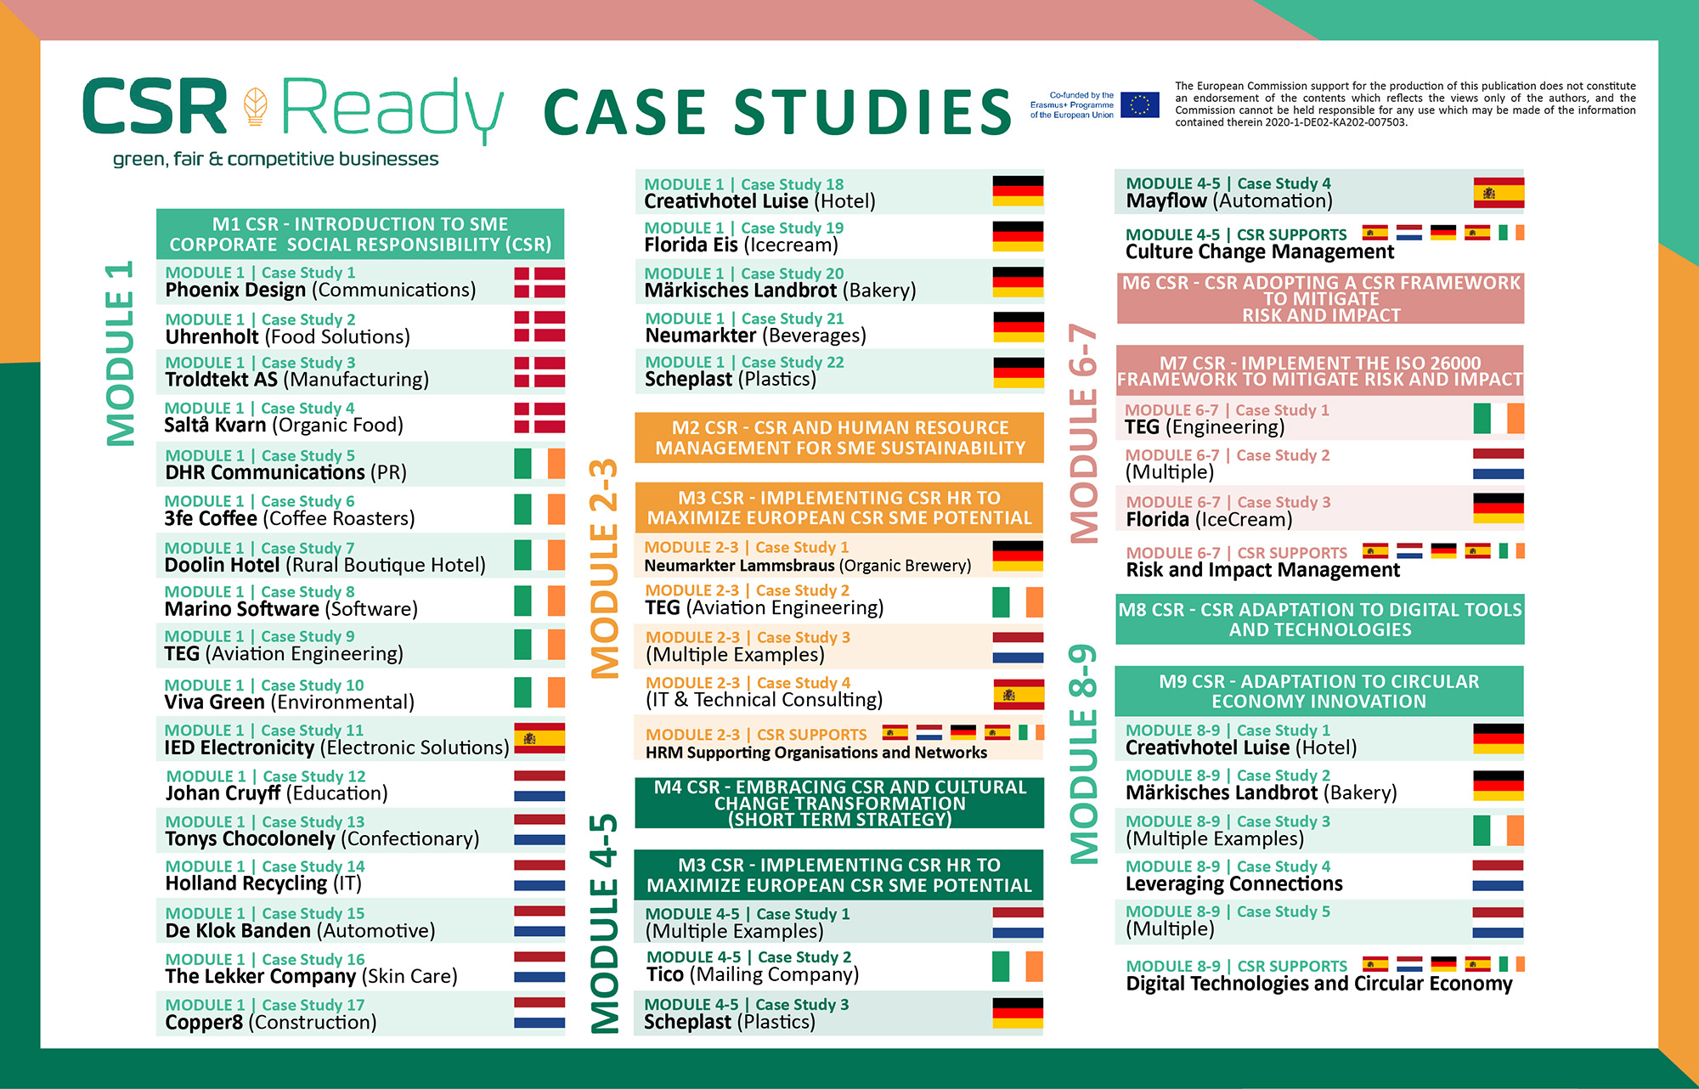

Slide 4
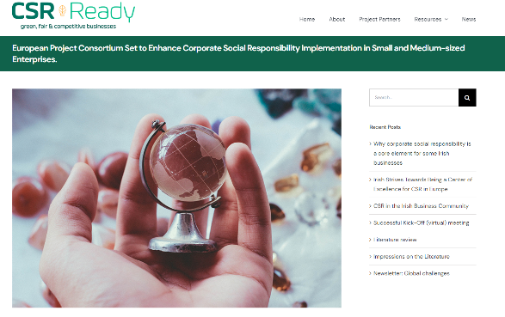
Corporate Social Responsibility (CSR) is about risk management, and risk management is about CSR.
If we can integrate the discipline of risk management and CSR, the result will be two-fold. CSR will automatically become more embedded into management processes as it will directly feed into strategic decision-making at all levels of a business. Secondly, it will encourage investment analysts to recognize and reward CSR.
(Source)
https://www.csrready.eu/

Slide 5
Overview of Module 6
Contents
This Module covers CSR as a critical factor in a business’s ability to continue operating effectively with minimal impact and risk. It demonstrates how CSR is a Sustainable business approach that provides tipple bottom outcomes - people, profit, and the planet. It covers how SMEs can implement CSR into their businesses via an internationally recognized standards system ISO26000. Learn the 7 Core Subjects and 7 Principles of Social Responsibility and implement them into the same framework. Get access to useful tools, guides, and videos on how an SME can practically implement a better way of working with society and the environment in which it operates. Module 7 Covers the second part of Module 6.
1
Realize the Benefits, Growth Opportunities and Advantages of Adopting a Globally Recognized CSR Framework (Using ISO 26000)
2
ISO 26000 7 CSR Core Subjects Covering Key Challenges That Should Be Addressed by SMEs
3
ISO 26000 7 CSR Core Principles That SMEs Should Take Into Account When Shaping their CSR
4
Covered in Module 7 Adopting the Roadmap on How to Implement CSR Sustainability and ISO 26000 Strategies

Slide 6
Learning Outcomes
Learn how to Implement CSR Sustainability and ISO 26000 Strategies for SMEs
Understand how to use the CSR Sustainability Roadmap
Be able to analyse your CSR performance and assess stakeholder expectations.
Learn how to identify your risks and impacts
Learn how to refine your analysis and conduct due diligence to develop a gap analysis
Define your priorities and understand how to implement a CSR Plan

Slide 7
Adopting a Globally Recognised CSR Standards Framework ISO 26000
SMEs are small but mighty! SMEs are at an advantage when implementing CSR using ISO26000. They are quickly adapting CSR not just to make their business look good but so CSR makes good business sense!
Section 1

Slide 8
SMEs Are Agile, Innovative and Connected
All businesses have risks and impacts, even small businesses, and therefore are responsible for doing their part in minimizing impacts in line with sustainability objectives. For a small business, no one expects a huge implementation like large corporates consisting of CSR policies, procedures, governance, and 100-page sustainability reports. However, your stakeholders are expecting to see evidence that your business is operating responsibly, including that you commit to managing your impacts and take action to do so. (Source)
The SME Advantage!! Small and medium businesses (SMEs) can often feel limited by their size, which limits the resources, budget, and expertise available to implement CSR. However, they often have an advantage over large businesses in implementing CSR due to their agility, innovation, and connectivity capability.

Slide 9
Realize the Growth Opportunities and Advantages
While working to comply with CSR expectations is an important first step, there is huge potential for growth and profit by viewing the challenges of sustainable development as a business opportunity.
There are innumerable challenges and unsolved dilemmas in achieving a sustainable world, and many companies and governments have committed to and are investing money in addressing them. If you are able to provide a solution that meets that need, you will be in high demand. Small businesses have a huge advantage in being innovative, enterprising, and agile to bring new solutions to the market. Going beyond responsive CSR compliance to offering products and services that provide a positive environmental or social outcome sets you apart in the market. Sustainability can be your differentiator, your blue ocean strategy, your early mover advantage, and your foot in the door. Your sustainability superpower!

Slide 10
Agility
Due to their smaller size and less complex structure, as well as often the freedom of not having external owners and shareholders, SMEs are more flexible and adaptable than large corporations and are therefore more able to change focus and structure to respond to changing circumstances and opportunities presented by environmental and social challenges.
Innovation
SME people are problem solvers. They are used to overcoming challenges within their business and are often more willing to look creatively at a market to innovate new and better solutions.
Connectivity
leaner, less hierarchical management structures enable a closer connection between decision-makers and implementers, allowing direct influence from senior management, involvement and buy-in of teams, dissemination of information (both instruction and results), and consistency of implementation, overall reducing the gap between rhetoric and action. (Source)

Slide 11
How Can SMEs Implement a European-Wide Accepted Sustainable & CSR Framework?
Many small businesses intuitively apply a responsible approach to business based on their own values. So, meeting your stakeholders' expectations merely requires articulating this and formalizing it into policies and a structured management approach. Aligning with commonly understood standards (e.g., ISO) and frameworks (such as UN Global Compact, and Global Reporting Initiative) also improves trust that you are doing the right thing. This section focuses on ISO 26000
https://www.iso.org/files/live/sites/isoorg/files/store/en/PUB100401.pdf

Slide 12
International Organization for Standardization (ISO)
ISO (International Organization for Standardization) is an independent, non-governmental internationally recognized organization with a membership of 167 national standards bodies. In 164 countries worldwide. Help businesses increase productivity while minimising errors and waste. Protecting people, profit and planet.
Watch Video
Official ISO Website
https://www.youtube.com/watch?v=MIssDGB7pJc

Slide 13
ISO 26000
A Set of Voluntary Global Standards to Implement CSR
In 2010, the International Organization for Standardization (ISO) released ISO 26000, a set of voluntary standards meant to help companies implement corporate social responsibility. Unlike other ISO standards, ISO 26000 provides guidance rather than requirements because the nature of CSR is more qualitative than quantitative, and its standards cannot be certified. ISO 26000 clarifies what social responsibility is and helps companies translate CSR and ESG principles into practical actions. The standard is aimed at all types of companies, regardless of their activity, size, or location. And because many key stakeholders from around the world contributed to developing ISO 26000, this standard represents an international consensus.

Slide 14
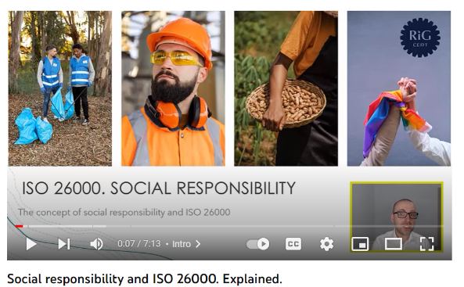
ISO 26000 Social Responsibility
For businesses and organizations committed to operating in a socially responsible way, there’s ISO 26000. It provides guidance to those who recognize that respect for society and the environment is a critical success factor. As well as being the “right thing” to do, ISO 26000 is increasingly viewed as a way of assessing a companies commitment to sustainability and its overall performance.
Watch Video
https://www.youtube.com/watch?v=QMape0BA3Ps

Slide 15
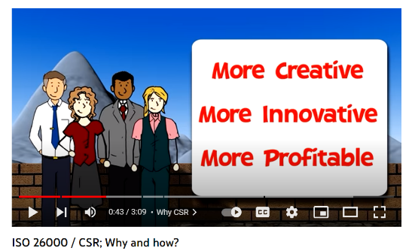
Why Choose ISO26000 to Support the Implementation of CSR Standards in SMEs?
https://www.youtube.com/watch?v=zFnE_rRjxiE
ISO 26000 was developed by a working group of about 500 experts. Document(s) to support the implementation of ISO 26000:
Communication Protocol – Describes appropriate wordings companies can use to communicate about their use of ISO 26000
ISO 26000 basic training materials in the form of a PowerPoint and training protocol guidance
Documents that link ISO 26000 with the OECD Guidelines for Multinational Enterprises and the United Nations 2030 Agenda (Sustainable Development Goals)

Slide 16
What Makes ISO 26000 Important and Credible?
Flexibility & Adaptability Regardless of Size or Location
It is designed to work in all organizational and cultural contexts – in any country or region
It is flexible and the user decides how to use it
Globally Recognised
It was internationally negotiated through ISO’s consensus method, using a multi-stakeholder approach, and balance to reflect global diversity. See the Appendix for more information about this process, and the different stakeholder groups.
Built By Real-Life SMEs and Lead by International Leadership
It incorporates the real-life experiences of its many contributors, and at the same time builds on international norms and agreements related to Social Responsibility

Slide 17
Companies Integrating CSR and ISO 26000 Measures
Shows a commitment to continual improvement by ‘doing good’ internally and externally
Attracts like-minded partners, investors, customers, and staff
Improves relations with employees, communities, the media, suppliers, and government agencies
Helps to establish more robust, stable supply chains
Contributes to sustainable development by reducing harmful environmental, social, and economic impacts
Help manage and reduce risks
Enables the identification of new opportunities
ISO 26000 Social Responsibility Manages Risk and Impact
Source ISO Social Responsibility

Slide 18
ISO2000
Increasing social responsibility contributes to a “virtuous cycle” where actions strengthen the company and the community, encouraging sustainable development
Watch Video
https://www.youtube.com/watch?v=MIssDGB7pJc
Source ISO Social Responsibility

Slide 19
ISO 26000 Social Responsibility Manages Risk and Impact
Assists companies to address their social responsibilities while respecting cultural, societal, environmental, and legal differences and economic development conditions
Provides practical guidance related to making social responsibility operational
Assist with identifying and engaging with stakeholders and enhancing the credibility of companies
Emphasize performance results and improvement
Increase confidence and satisfaction among company customers and other stakeholders
Achieves global consistency with existing documents, international treaties and conventions, and existing ISO standards
Promote common terminology in the CSR and social responsibility field
Broaden awareness of social responsibility and its potential to be adapted
Source ISO Social Responsibility

Slide 20
Source ISO Social Responsibility

Slide 21
Social Responsibility (SR) lies at the heart of ISO2000. This is the responsibility a company has regarding the impact of its decisions and activities on society and the environment through transparent and ethical behaviours that:
Contributes to sustainable development, including the health and welfare of society
Considers the expectations of stakeholders
Is compliant with applicable law and consistent with international norms of behavior, and
Is integrated throughout the company and practiced in its relationships.
Source ISO Social Responsibility

Slide 22
ISO 26000 7 CSR Core Subjects Covering Key Challenges That Should Be Addressed by SMEs
Introductory Blog on 7 Core Subjects.
Section 2

Slide 23
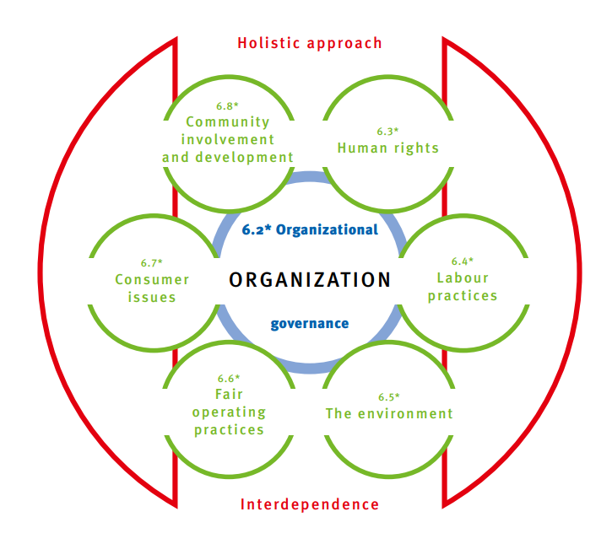
Social Responsibility
7 Core Subjects
6.2 Organisational Governance
6.3 Human Rights
6.4 Labour Practices
6.5 The Environment
6.6 Fair Operating Practices
6.7 Consumer Issues
6.8 Community Involvement and Development
Source Download Poster

Slide 24
Organisational Governance 6.2
Business governance and accountability involve an obligation on management to be answerable to the controlling interests of the organization and on the organization to be answerable to legal authorities with regard to laws and regulations.
Fair
operating
practices
Good community relations
Loyalty of workers and customers
An organization should account for:
the impacts of its decisions and activities on society, the environment and the economy, especially significant negative consequences; and
the actions are taken to prevent the repetition of unintended and unforeseen negative impacts.

Slide 25
Organisational Governance 6.2
Decisions are to be made in consideration of the expectations of society. Accountability, transparency, ethics, and stakeholders should be factors in the company’s decision-making process.
See Page 37 For More Information on Governance
6.2.2 Principles and considerations. Effective governance should be based on incorporating the principles of social responsibility into decision-making and implementation. In addition to these principles, a company should consider the practices, the core subjects and the issues of social responsibility when it establishes and reviews its governance system.
6.2.3 Decision-making processes and structures. All companies should put in place processes, systems, structures, or other mechanisms that make it possible to apply the principles and practices of social responsibility.

Slide 26
Human Rights 6.3
All humans have the right to fair treatment and the elimination of discrimination, torture, and exploitation.
6.3.3 Due diligence
6.3.4 Human rights risk situations
6.3.5 Avoidance of complicity
6.3.6 Resolving grievances
6.3.7 Discrimination and vulnerable groups
6.3.8 Civil and political rights
6.3.9 Economic, social, and cultural rights
6.3.10 Fundamental principles and rights at work
See Page 36 For More Information on Human Rights

Slide 27
Labour Practices 6.4
Those working on behalf of the company are not a commodity. The goal is to prevent unfair competition based on exploitation and abuse.
https://www.ihrec.ie/download/pdf/guidelines_for_employment_equality_policies_in_enterprises.pdf
See Page 40 For More Information on Employment and Labour Practices
6.4.3 Employment and employment relationships
6.4.4 Conditions of work and social protection
6.4.5 Social Dialogue
6.4.6 Health and safety at work
6.4.7 Human development and training in the workplace

Slide 28
The Environment 6.5
The company has a responsibility to reduce and eliminate unsustainable volumes and patterns of production and consumption and to ensure that resource consumption per person becomes sustainable.
6.5.3 Prevention of pollution
6.5.4 Sustainable resource use
6.5.5 Climate change mitigation and adaptation
6.5.6 Protection of the environment, biodiversity, and restoration of natural habitats
See Page 42 For More Information on Environment

Slide 29
Fair Operating Practices 6.6
Building systems of fair competition, preventing corruption, encouraging fair competition, and promoting the reliability of fair business practices help to build sustainable social systems
6.6.3 Anti-corruption
6.6.4 Responsible political involvement
6.6.5 Fair competition
6.6.6 Promoting social responsibility in the value chain
6.6.7 Respect for property rights
See Page 45 For More Information on Fair Operating Practices

Slide 30
Consumer Issues 6.7
The promotion of just, sustainable, and equitable economic and social development with respect to consumer health, safety, and access is the company’s responsibility.
6.7.3 Fair marketing, factual, and unbiased information and fair contractual practices
6.7.4 Protecting consumers' health and safety
6.7.5 Sustainable consumption
6.7.6 Consumer service, support, and complaint and dispute resolution
6.7.7 Consumer data protection and privacy
6.7.8 Access to essential services
6.7.9 Education and awareness
See Page 48 For More Information on Consumer Rights

Slide 31
Community Involvement and Development 6.8
The company should be involved with creating sustainable social structures where increasing levels of education and well-being can exist.
6.8.3 Community involvement
6.8.4 Education and culture
6.8.5 Employment creation and skills development
6.8.6 Technology development and access
6.8.7 Wealth and income creation
6.8.8 Health
6.8.9 Social investment
See Page 50 For More Information on Community Development

Slide 32
ISO 26000 7 CSR Core Principles That SMEs Should Take Into Account When Shaping their CSR
Introductory Blog on 7 Core Principles.
Section 3

Slide 33
7 Principles
Accountability
Transparency
Ethical behaviours
Respect for stakeholder interests
Respect for the rule of law
Respect for international norms of behaviour
Respect for human rights
7 Core Subjects
Holistic Integrated Approach
Interdependence
Community Involvement and
Development
Human
Rights
Organizational
Governance
Consumer Issues
Company
Labour Practices
Fair Operating Practices
The Environment
Source
Source ISO Social Responsibility

Slide 34
Principles 1 & 2 Accountability and Transparency
Open and Answerable to Decisions and Activities of Governing and Legal Bodies
Accountability is the: “state of being answerable for decisions and activities to the company’s governing bodies, legal authorities and, more broadly, its stakeholders” (those who are affected by its actions)
Transparency is “openness about decisions and activities that affect society, the economy and the environment, and willingness to communicate these in a clear, accurate, timely, honest and complete manner”
Source: ISO 26000:2010 Clause 2.1 and 2.24
Source ISO Social Responsibility

Slide 35
Principles 1 & 2
Accountability and Transparency
Leaders need to know and acknowledge who has made what specific decisions
Accountability and Transparency involve taking responsibility for decisions and policies.
Accountability and transparency involve the top decision-makers, as well as everyone throughout a chain of command.
Leaders should practice and promote ethical behaviour, accountability, and transparency. ISO 26000 suggests tools for integrating SR into core company decisions.
Source ISO Social Responsibility

Slide 36
Managing Financial Transparency, Impacts and Risks
Financial responsibility is the pillar of corporate social responsibility that ties all company elements together. If a company makes plans to be more environmentally, ethically, and philanthropic for example it must back these plans through financial investments in programs, donations, or product research. This includes :
Ensure transparent and timely financial reporting including external audits
Adjust company structure to include a third-party review of sensitive areas such as financial management, etc.
Research and development for new products that encourage sustainability.
Recruiting different types of talent to ensure a diverse workforce
Initiatives that train employees on DEI, social awareness, or environmental concerns. Also, to develop incentives for performance on social responsibility
Processes that might be more expensive but yield greater CSR results
Create ways to track decisions and their implementation, to ensure CSR accountability and follow-through
Implement processes for meaningful (two-way) CSR communication with stakeholders
Source Investopedia

Slide 37
Principle 3
Ethical Behaviour
Doing the right thing daily!
Ethical behavior involves deciding what is the right course of action, day to day
Ethical behavior is defined as “behavior that is in accordance with accepted principles of right or good conduct in the context of a particular situation…”
Ask yourself: would you be comfortable if your actions were to become public knowledge?
Source: ISO 26000:2010 Clause 2.7
Source ISO Social Responsibility

Slide 38
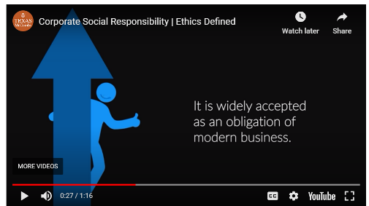
CSR is Modern Business
Corporate Social Responsibility, or “CSR,” refers to the need for businesses to be good business citizens. CSR involves going beyond the law’s requirements in protecting the environment and contributing to social welfare. It is widely accepted as an obligation of modern business.
CSR goes beyond earning money for shareholders. It’s concerned with protecting the interests of all stakeholders, such as employees, customers, suppliers, and the communities in which businesses operate. Examples of CSR include adopting humane employee practices, caring for the environment, and engaging in philanthropic endeavours.
Watch Video

Slide 39
CSR is growing — companies are also acknowledging the importance of corporate social responsibility in business. It is giving a new competitive edge.
Companies Spend Money with CSR Companies As Awareness Grows; The growing public awareness of CSR issues has led to an expectation that the company's customers spend money with are 'doing the right thing' regarding their social citizenship. The approach of a business mirrors the priorities of its customers via its ethics. For example, it reduces carbon footprint, positively impacts the communities it operates in, and ensures internal practices meet the highest compliance and government standards.
CSR impacts the brand image. It has been evident in recent years, with numerous examples of a company's supply chain, employment practices, and environmental performance having the potential to derail its reputation.
Principle 3
Ethical Behaviour
Ethics protects a business and its reputation.
Environmental Sustainability has risen to the top of many brand agendas.

Slide 40
Brand Recognition
According to a study published in the Journal of Consumer Psychology, consumers are more likely to act favourably towards a company that has acted to benefit its customers as opposed to companies that have demonstrated an ability to deliver quality products.
Customers are increasingly becoming more aware of the impacts companies can have on their community, and many now base purchasing decisions on the CSR aspect of a business. As a company engages more in CSR, they are more likely to receive favourable brand recognition. (Source)

Slide 41
Corporate Social Responsibility (CSR) is standard practice for most businesses. No matter what the size, there is an expectation that businesses should do the right thing – from helping those in need to tackling issues that will make the world a better place. This expectation is almost becoming a demand, watched closely by all stakeholders, including shareholders, employees, customers, and regulators/governments.
The “Brands and CSR Survey Report” undertaken by the International Trademark Association (INTA) in 2019 revealed that CSR efforts can contribute to brand value and brand loyalty if they are made public.
84% of respondents agreed that CSR policies and adopting sustainability principles as an operational priority “constitutes good economic practice and will benefit a company and/or brand.” Further, almost 58% agreed that the absence of CSR policies and practices puts companies and brands at a disadvantage in the market.
The results of the Survey are reinforced by the 2020 Global Web Index report 43% of ​those between 16 to 24, who aren’t even aware of what CSR is, are willing to pay a premium for a brand that has a positive impact on the environment or society, while the number of consumers who would pay more for eco-friendly products has risen from 49% in 2011 to 57% in 2019. (Source)

Slide 42
Some of the most common examples of CSR that can strengthen a brand include:
Reducing carbon footprints
Improving labour policies
Participating in fairtrade
Diversity, equity, and inclusion
Charitable global giving
Community and virtual volunteering
Corporate policies that benefit the environment
Socially and environmentally conscious investments

Slide 43
Case Study
Dutch Confectionary Tony’s Chocolonely advocates for a slave free global supply chain
The Dutch confectionery company Tony’s Chocolonely specializes in delicious, fair-trade chocolate treats.
They also specialize in advocating for farmers’ rights and a slave-free global chocolate supply chain. Yup, you read that right. Modern slavery is an unfortunate reality in the cocoa industry.
This tragedy continues because the majority of consumers are far removed from the processes that bring goods into stores for them to purchase.
https://sproutsocial.com/insights/corporate-social-responsibility-examples/

Slide 44
Case Study
CSR is not just a practice its part of Tony’s Chocolonely’s Brand Mission
This distance prevents these incredibly harmful practices from being seen, considered, or discussed at large. That’s where Tony’s Chocolonely comes in. It raises awareness on the issue of modern slavery every chance they get. It’s in their packaging, across their website, and a major theme throughout their social content. For Tony’s Chocolonely, corporate social responsibility is more than practice: it’s a part of the brand’s mission.
Takeaway: If you’re trying to raise awareness on a specific cause, create a more cohesive story by tying your social corporate responsibility content back to an overarching brand messaging framework.
https://sproutsocial.com/insights/corporate-social-responsibility-examples/

Slide 45
Protect and Enhance Consumer Experiences
Integrate into Core Business Model
Protect consumers’ health and safety; design and test products to ensure this
Reduce waste by minimizing packing material and, if appropriate, offer recycling and disposal services
Eliminate or minimize negative health and environmental impacts of products and services, such as noise or waste
Pay particular attention to the information needs of vulnerable individuals (for example, those with limited vision or hearing, or poor reading ability)
Source ISO Social Responsibility

Slide 46
Benefit and Enhance Community Experiences
Integrate into Core Business Model
Focus on local job creation, hiring, skill development, and provision of health, welfare, and other services
Consult directly with community members before designing programs
When investing in a community, consider the economic, social, and environmental impacts of your investment
Respect the traditional uses of natural resources by local populations, especially indigenous peoples
Fulfill tax and other legal responsibilities as described in the law, even when punishments are not likely
Consider “social investment” programs and infrastructure which will improve quality of life, and will increase the capacity of the community to develop sustainably
Source ISO Social Responsibility

Slide 47
CSR can support marketing and PR efforts but be careful not to get exposed to Greenwashing, ‘the practice of overstating achievements for their own ends’
As Prezly state, there's undoubtedly a 'complex relationship between corporate social responsibility and PR.' While CSR provides an excellent story for corporates seeking positive publicity, the story should be secondary to a genuine concern for ethics and a desire to fulfil their social responsibility. In other words, ‘there's nothing wrong with publicizing your CSR wins, but seeking to 'do' corporate social responsibility only for the PR benefits, or exaggerating your successes for PR purposes, is likely to backfire because consumers, investors, and the wider public see through your attempts’.
Principle 3
Ethical Behaviour
Ethics and CSR is a Vehicle for PR and Positive Communication and Reputation but be Careful Not to Greenwash

Slide 48
Read More Business Ethics and Corporate Social Responsibility
What is Corporate Social Responsibility in Business Ethics?
How Do Ethics Differ From Corporate Social Responsibility?
Why Should Businesses Act Ethically?
The Principles of Corporate Social Responsibility and Business Ethics
Ethics and Corporate Social Responsibility in Strategic Planning
CSR as a Vehicle for PR
Transparency: The New Normal
Considering Stakeholders in CSR and Ethics
Ethical Leadership and Management
Principle 3
Ethical Behaviour
FURTHER READING

Slide 49
Managing Ethical Risks, Impacts and Responsibilities
Ethical responsibility is the pillar of corporate social responsibility rooted in acting in a fair, ethical manner. Companies often set their own standards, though external forces or demands by clients may shape ethical goals. Instances of ethical responsibility include:
Fair treatment across all types of customers regardless of age, race, culture, or sexual orientation.
Positive treatment of all employees including favourable pay and benefits in excess of mandated minimums. This includes fair employment consideration for all individuals regardless of personal differences.
Expansion of vendor used to utilize different suppliers of different races, genders, Veteran statuses, or economic statuses.
Honest disclosure of operating concerns to investors in a timely and respectful manner. Though not always mandated, a company may choose to manage its relationship with external stakeholders beyond what is legally required.
Source Investopedia

Slide 50
Managing Ethical Risks, Impacts and Responsibilities
Everyone should be able to earn a living wage through freely chosen work (not forced labor or slavery). All workers should experience just and favorable conditions at work. Responsibility goes beyond workplaces that a company owns or directly controls
Eliminate child labor and forced labor
Comply with laws and regulations on the rights of unions and collective bargaining, and social protection (medical coverage, disability leave, etc.
Eliminate discrimination in hiring and dismissals
These are recognized as basic human rights (ISO 26000:2010, 6.3)
Understand and control the health and safety risk involved in activities; provide safety equipment and training
Consider the impact on workers’ family lives when making scheduling decisions
Avoid contracting with suppliers or sub-contractors who use unfair or abusive labor practices, including child labor
Source ISO Social Responsibility

Slide 51
Fair Ethical Operating Practices
Practice honesty – don’t ask for or accept bribes; don’t attempt to break laws through the use of political influence
Respect property rights; pay fair compensation for property you acquire or use
Treat suppliers and customers/consumers fairly, including prompt payment of bills and prompt attention to problems
Examine your value chain/supply chain, and be sure you are paying enough to enable your suppliers to fulfil their own social responsibilities
Source ISO Social Responsibility

Slide 52
Principle 4
Respect for Stakeholder Interests
Awareness of Impact on Others
This involves identifying groups of stakeholders. That is those who are affected by your decisions and actions - and responding to their concerns. It does not mean letting them make your decisions.
Note that, by definition, “social responsibility” always involves reference to the guiding principles, and awareness of impacts on others.
Identifying stakeholders and developing channels of communication with them is one of the most rewarding and can be the most challenging part of Social Responsibility. This is fantastic for exchanging knowledge, suggestions, complaints, and ideas for solutions. Start to communicate respect and willingness to engage before a crisis emerges. The goal is to build trust and credibility for the long term, not to find “quick fixes” for problems.

Slide 53
Principle 4
Respect for Stakeholder Interests
Respect, consider and respond to the interests of stakeholders
A company should:
Identify its stakeholders and recognize and have due regard for their interests as well as the legal rights of its stakeholders and respond to their expressed concerns;
Recognize that some stakeholders can significantly affect the activities of a company;
Assess and take into account the relative ability of stakeholders to positively engage and influence a company;
Take into account the relation of its stakeholder’s interests to the broader expectations of society and to sustainable development, as well as how they can possibly work together for the greater collective good;
(Source)
Stakeholders, and Why It Is Important to Identify Their Interests Get a different perspective, gain more support and improve a company’s success rate

Slide 54
Learn Effective and Respectful Communication With Stakeholders To Respect their Values
Consultation and negotiation with stakeholders are key components of many businesses. These can include development proposals, the management of natural areas, products, policies, and legislation. There may be many reasons why companies or bodies engage with their stakeholders. For some, it may simply be ‘because they have to’ while for others it may be to gain an honest understanding of the factors stakeholders are most interested or concerned about and work with these in mind. Regardless of the reason, the success of the project will likely be influenced by the effectiveness of the stakeholder engagement.
(Read More How to Do This – Respecting Stakeholder Values Source)
Principle 4
Respect for Stakeholder Interests
Integrate Sustainability Environment, Safety, and Community Through Stakeholders

Slide 55
Sustainable Supply Chains Through CSR Risk Management
European SDG Summit 2020-Impactful Partnerships to Build Back Better.
How can companies address Corporate Sustainability and Responsibility (CSR) risks and threats and contribute to reaching the SDGs?
Includes practical examples with Tony Chocolonely and Hakro to explain how to successfully address CSR risks and achieve SDG impact.
View Agenda: https://bit.ly/35VQx5Z
For more information: https://www.csreurope.org/european-sd...
Watch Video
https://www.youtube.com/watch?v=BPtoDVGFEFI

Slide 56
Using Philanthropy to Manage Impact and Risk with Stakeholders in Society
Philanthropic responsibility is the pillar of corporate social responsibility that challenges how a company acts and how it contributes to society. In its simplest form, philanthropic responsibility refers to how a company spends its resources to make the world a better place. This includes:
Whether a company donates profits to charities or causes it believes in
Whether a company only enters into transactions with suppliers or vendors that align with the company philanthropically
Whether a company supports employee philanthropic endeavours through time off or matching contributions
Whether a company sponsors fundraising events or has a presence in the community for related events
Source Investopedia

Slide 57
Principle 5
Respect for Rule of Law
Comply with Law and Regulation and Have Established Procedures
“In the context of social responsibility, respect for the rule of law means that a company complies with all applicable laws and regulations….even if they are not adequately enforced.”
The rule of law refers to the supremacy of law and to the idea that no individual or company stands above the law and that government is also subject to the law. The rule of law contrasts with the arbitrary exercise of power. It is generally implicit in the rule of law that laws and regulations are written, publicly disclosed, and fairly enforced according to established procedures. (Source)
Source: ISO 26000:2010 Clause 4.6
Source ISO Social Responsibility

Slide 58
Principle 5
Respect for Rule of Law
Protects Citizens and Businesses. It is harder to function in companies where ‘law is weak’.
This concept is called the “rule of law” and affects everything about where people work and how they live. By having a strong rule of law, governments give businesses and society the stability of knowing that all rights are respected and protected. A strong rule of law includes where a company has:
Clearly written and easily accessible laws that create certainty and enforceability of legal rights
An independent and impartial judiciary or auditor that promotes fairness and ensures transparent, timely, and predictable resolution of disputes
There are great benefits to businesses, and other stakeholders, in respecting and supporting the rule of law. Where the rule of law is weak, it is harder for responsible businesses to function, meet their legal obligations, and have their legal rights protected.
United Nations Promote the Rule of Law to Protect Citizens and Businesses

Slide 59
A Company Should;
Comply with legal requirements in all jurisdictions in which a company operates, even if those laws and regulations are not adequately enforced;
Ensure that its relationships and activities comply with the intended and applicable legal framework;
Keep itself informed of all legal obligations; and
Periodically review its compliance with applicable laws and regulations.
Use the Business for Rule of Law Framework
Principle 5
Respect for Rule of Law
Comply with Law and Regulation and Have Established Procedures

Slide 60
Consider adverse activities such as discrimination against employee groups, disregard for natural resources, or unethical use of company funds. This type of activity is more likely to lead to lawsuits, litigation, or legal proceedings where the company may be negatively impacted financially and be captured in headline news. By adhering to CSR practices, companies can mitigate risk by avoiding troubling situations and complying with favorable activities (Source)

Slide 61
Principle 6
Respect For International Norms Of Behavior
Comply with Wildly Shared Expectations and Generate Greater Acceptance
“In situations where the law or its implementation does not provide for adequate environmental or social safeguards, a company should strive to respect, as a minimum, international norms of behavior.”
International norms of behavior are “…derived from customary international law, generally accepted principles of international law, or intergovernmental agreements that are universally or nearly universally recognized.”
These can be found in authoritative international instruments from companies such as the United Nations, International Labour Organization (ILO).
Sources: ISO 26000:2010 Clause 2.11 and 4.7
Source ISO Social Responsibility

Slide 62
Managing Environmental Risk, Impact and Responsibility
Environmental responsibility is the pillar of corporate social responsibility rooted in preserving mother nature. Through optimal operations and support of related causes, a company can ensure it leaves natural resources better than before its operations. Companies often pursue environmental stewardship through:
Reducing pollution, waste, natural resource consumption, and emissions through manufacturing processes
Recycling goods and materials throughout processes including promoting re-use practices with its customers
Offsetting negative impacts by replenishing natural resources or supporting causes that can help neutralize the company's impact. For example, a manufacturer that deforests trees may commit to planting the same amount or more
Distributing goods consciously by choosing methods that have the least impact on emissions and pollution
Creating product lines that enhance these values. For example, a company that offers a gas lawnmower may design an electric lawnmower.
Source Investopedia

Slide 63
Human rights due diligence is a potential game changer for companies: from “naming and shaming” to “knowing and showing.” Naming and shaming is a response by external stakeholders to the failure of companies to respect human rights.
Knowing and showing is the internalization of that respect by companies themselves through human rights due diligence.
As you know, companies routinely conduct due diligence to satisfy themselves that a contemplated transaction has no hidden risks. Internal controls for the ongoing management of risks to both the company and stakeholders who could be harmed by its conduct — for example, to prevent employment discrimination, environmental damage, or criminal misconduct.
Principle 7
Respect for Human Rights
Respect human rights means avoiding infringing on the rights of others, and addressing adverse impacts that may occur. It applies to all companies in all situations.

Slide 64
Managing Human Rights Risks and Impacts
ISO 26000 encourages users to identify and respond to members of vulnerable groups within their sphere of influence
Users should avoid complicity; that is, avoid assisting those abusing others, and avoid benefiting directly from abuses committed by someone else
Some example measures
Develop mechanisms for “due diligence”: ways to identify, address and prevent actual or potential human rights damage resulting from your activities
Examine the treatment of vulnerable individuals and groups in your company, such as indigenous peoples, girls, and women, those historically discriminated against on the basis of race, ethnicity, or religion, people with disabilities, the elderly, migrants, etc.
Provide remedy, solutions, and grievance procedures
Source ISO Social Responsibility

Slide 65
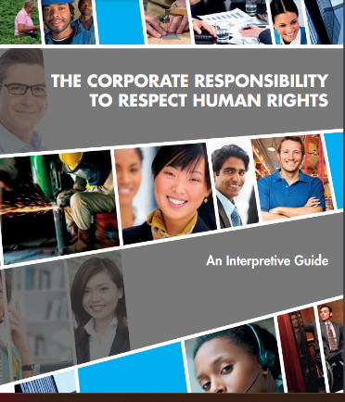
ISO 26000 urges its users to identify the vulnerable populations among its stakeholders and to work to ensure their fair treatment
“..In situations where human rights are not protected, take steps to respect human rights and avoid taking advantage of these situations…” Source: ISO 26000:2010 Clause 4.8
Principle 7
Respect for Human Rights
Human Rights due diligence can help companies lower their risks including the risk of non-compliance.
(Read More on How)
United Nations Guide to Human Rights

Slide 66
Example Case Studies How CSR
Mitigates Risk and Impact for European SMES
Case Studies
Florida Eis Ice Cream, Germany
NINE & Co Children’s Clothes Netherlands
TEG Engineering, Ireland
NINE & Co work closely with a smaller number of suppliers, enabling them to increase transparency, build stronger relationships and increase insight into the supply chain. Between 2017-2019 they decreased from over 100 suppliers to 48 suppliers. The majority of their suppliers are a member of and audited by, a social compliance standard. Each year NINE & Co visit the factories of suppliers to work on the quality, safety and wellbeing of workers and working conditions.
See CSR Case Studies to learn how they mitigate risk and impact using CSR approaches. TEG for example incorporate product and quality information, payment policies, employee health and safety, sustainable product design, environmental impact policies and even have an Eco Merit Environmental Certification to endorse their company CSR reputation.
Florida Eis has managed to convert its operations and production to CO2 Neutral since 2013 by implementing innovative technologies resulting in optimal energy savings. They are committed to local community charities and have a commitment charter to the environment, plant and animal world. … See full Case Study here.

Slide 68
Well Done!
You Have Completed Module 6
Next is Module 7
Implement the ISO 26000 Framework to Mitigate Risk and Impact
https://www.csrready.eu/
Facebook

