Slide 1
Module 4
Embracing CSR and Cultural Change Transformation – Short Term Strategy Approach
"The European Commission support for the production of this publication does not constitute an endorsement of the contents which reflects the views only of the authors, and the Commission cannot be held responsible for any use which may be made of the information contained therein 2020-1-DE02-KA202-007503’
This resource is licensed under CC BY 4.0

Slide 3
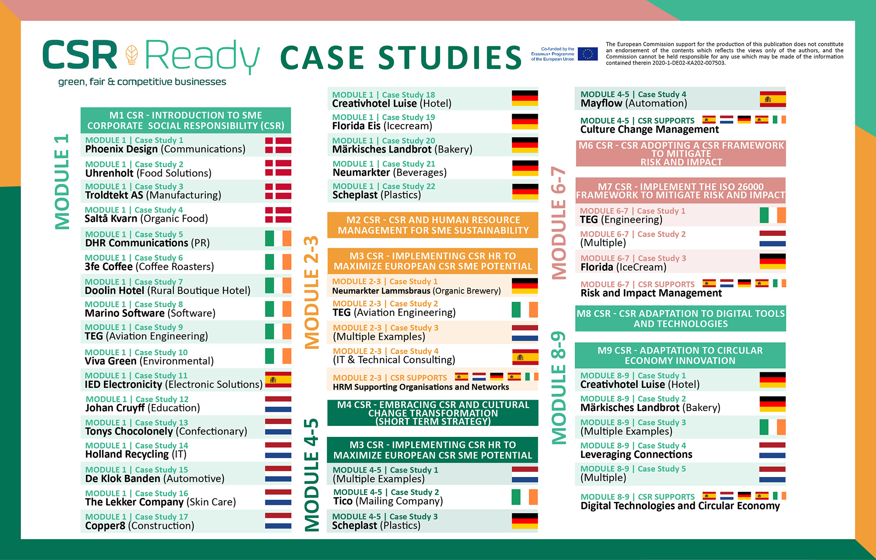

Slide 4
Overview of Module 4
1
Introduction & SME CSR Cultural Change Management & How the Appetite for Adaptation is Stronger Than Ever
This Module you will explore how and when to effect CSR cultural change to improve the performance of your company. You will learn how to deep dive into cultural transformation at the right time for your company —this is a type of change initiated at the executive leadership level. It explains how CSR cultural transformation is a holistic, dynamic process that encapsulates the whole company including stakeholder minds, attitudes and beliefs – essentially a way of doing business differently but better. It demonstrates that to begin your CSR journey a ‘pure’ CSR approach isn’t needed nor does it need to be embedded in core business operations and products. The most important thing is for SMEs to get on the CSR journey and build it gradually by starting small and engaging in external CSR activities. CSR is different for every business depending on its size, resources and model this Module explains how SMEs can develop an adaptable model.
2
How CSR Innovation Should Be Front and Centre of a Company’s Culture
3
Dig Deeper into the Benefits of SME Cultural Change Management
4
Activating CSR Cultural Change Management– Short-Term Strategic Approach

Slide 5
Learning Outcomes
Understand What CSR and Cultural Change Management Means & Why They are Important
Explore how Cultural Transformation is About Changing a Company’s Mindset
Learn how to deep dive into cultural transformation by using a quick short and term strategy focusing on external activities first
Explore the different CSR cultural change activities a company can engage in
Understand why it is important and beneficial to engage even in a short-term CSR strategy however this should be supported by a long-term strategy and not just be a company one-off. This is to get you started and familiar with new CSR approaches that are easy to implement.

Slide 6
Introduction to CSR & Cultural Change Management
Section 1

Slide 7
Companies are Expected to Be Responsible by Society
CSR should be seen as the way that companies —working with those most affected by their decisions (often called “stakeholders”)—can develop innovative and economically viable products, processes and services within core business processes, resulting in improved environmental protection and social conditions. In other words, aligning core business strategy with the changing social and environmental context. (source Paul Hohnen, and Jason Potts Implementing Guide for Business)
“Social responsibility (is the) responsibility of an organisation for the impacts of its decisions and activities on society and the environment through transparent and ethical behaviour that is consistent with sustainable development and the welfare of society; takes into account the expectations of stakeholders; is in compliance with applicable law and consistent with international norms of behaviour; and is integrated throughout the organisation.” Working definition, ISO 26000 Working Group on Social Responsibility, Sydney, February 2007

Slide 8
Good Entrepreneurs Know that CSR Delivers Success Not Just for them but For the Communities They Reside
Businesses are an integral part of the communities in which they operate. Good entrepreneurs know that their long-term success is based on continued good relations with a wide range of individuals, groups, societies, communities and the environments they operate in. Smart firms know that they can’t succeed in societies that are failing—whether due to social or environmental challenges, or governance problems. More importantly the general public has high expectations of the private sector in terms of responsible behaviour. Consumers expect goods and services to reflect socially and environmentally responsible business behaviour at competitive prices. Shareholders are searching for enhanced financial performance that integrates social and environmental considerations, both in terms of risk and opportunities.

Slide 9
CSR Integration is Mandatory in Certain Countries
SMEs more than ever need to take important steps to support now and into the future so they can accelerate responsible business practices across their employee strategies, supply chains, customer management and production operations. CSR presents numerous benefits for businesses regardless of their size such as higher motivation and productivity amongst workers, enhanced reputation and access to global markets.
In certain countries CSR is now a mandatory requirement with existing legislations and standards on CSR issues such as environment, human rights and labour rights.
SME’s cultural change management can seem difficult for some as supply chains may be complex and composed of diverse supply chain actors, there may be a limited supply of skilled employees and CSR resources may be restricted. These Businesses may want to start their sustainability journey but are unsure where to start and what the business case is for doing so.

Slide 10
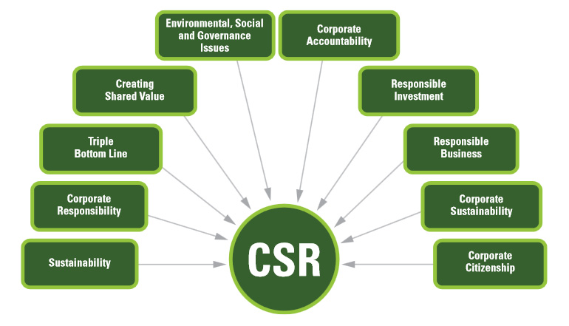
CSR Terminology
Source

Slide 11
The Need and Appetite for CSR in European Companies Is Higher Than Ever
One of humankinds greatest challenge is to ensure sustainability, just and balanced development, quality of life and protection of the earth.
CSR social, environmental and economic values sit at the core of protecting our natural world, social and economic values.
Everyone is responsible, including businesses, in fact the role of the business sector is critical. Strategically, businesses can only flourish and remain sustainable when its communities and ecosystems in they operate are healthy.
This Module focuses on how SMEs across Europe can practically design and implement CSR Cultural Change Management in their companies.

Slide 12
Definitions of Cultural Change and Transformation
Definition of Company Culture refers to the values, beliefs, and behaviours of an organization’s employees and leadership, ultimately determining how the company performs—financially and otherwise as well as its ability to attract and retain quality clients and employees. Source Builtin
CSR Company Culture A CSR Company Culture is what makes your company special and sustainable. It is the culmination of shared goals, attitudes and beliefs that integrate CSR. It can be influenced by a number of things, including your management style, work environment, ethics, vision, staff ethic, expectations and values.
It makes sense that corporate social responsibility is tied directly to a company culture, as CSR is a company’s commitment to being socially accountable to itself, employees, stakeholders and the world. Source
Tip
Start by adapting your current culture by underpinning it with CSR environmental, social and economic consideration and positive impact!

Slide 13
Definitions of Cultural Change and Transformation
CSR Cultural Change is how processes or standards are transformed in order to improve a team, a department, or an company. CSR Cultural Change is when the standards and processes have a CSR focus i.e., environmental, social and economic focus.
A CSR Culture Shows You Care! CSR shows your employees and the public that you care. Whether it’s painting a school or taking a hard look at how your business could be more environmentally friendly, your CSR initiatives show that you care. Source
CSR Cultural Transformation how a company reconsiders its values, mission/purpose, and vision, doing extensive, focused work across the company to radically improve its CSR culture

Slide 14
CSR Innovation Should Be Front and Centre of a Company’s Culture
Section 2

Slide 15
Cultural Transformation is About Changing a Company’s Mindset
Cultural CSR change goes beyond changing obvious forms (structure, process, etc.) to values and deeper changed mindsets. CSR cultural transformation is holistic and dynamic, and encapsulates the whole company its systems, beliefs, values, and the minds of its employees.
CSR is more important than ever gearing businesses towards improved business performance and sustainability e.g., increased revenue, minimising negative impact, reduced risk, enhanced reputation, quality suppliers and clients, customers satisfaction and retention, ability to compete in the market, employee support and engagement, higher potential to attract and retain quality employees, reduced absenteeism, more efficient operations….
With a growing emphasis on corporate social responsibility (CSR), companies must decide how to integrate CSR into their organizational strategy. For most companies, CSR has been a tool for improving business performance (e.g., Lindgreen et al. 2009; Weaver et al. 1999a)

Slide 16
CSR Innovation Should Be Front and Centre of Company Culture
Innovation is considered as the most viable path to support and strengthen current business sustainability while treating and overcoming environmental and social crises. Source
CSR and innovation are two sides of the same coin. They need to work together to combat unprecedented social and environmental challenges, tackle a global market of constant change and continuously meet market and stakeholder needs.
Why is it More Important Now Than Ever? Given the mega global challenges we face such as poverty increases, widespread violent conflict, intense climate change and the worsening of the ecological crisis, it is this current complex multidimensional business framework that has intensified the NEED for corporate social engagement. So instead of businesses refraining it is a necessity they adopt socially and ecologically responsible behaviours while ensuring their growth.

Slide 17
CSR Innovation Should Be Front and Centre of Company Culture
Where does culture management come in? Today, company culture is front and centre to CSR innovation. Companies need high performing employees and an upskilled team of workers, managers and creative professionals to drive CSR innovation and company sustainability. They need to understand CSR so they can be fully engaged especially when it is a new addition to your business strategies.
This is achievable through training and the support of cultural change management so that they can deliver and adapt to CSR performance outcomes and business goals. If this is a new area for you, you will need to adjust and change your company’s culture, management and dynamics.
Culture management impacts external stakeholders too Its not only about your internal people but also external customers, stakeholders, potential employees who reward and support companies with positive cultures and values, and turn away from those with poor cultures. Even if you’re a small company there are many ways to influence your CSR culture.

Slide 18
Internal CSR Cultural Change Improves Innovation and Sustainability Employees are more motivated, they feel safer and more comfortable in responsible companies, which drives better information sharing and improved morale. Furthermore, a stakeholders’ synergy, built through CSR, promotes identifying new opportunities and better ways of doing things. Interacting and understanding stakeholders’ needs will lead to greater innovation opportunities detection. Strategic CSR should lead to thinking-out-of-the-box in a way that improves the corporate creativity and enhances innovation capacities. CSR engagement leads to get in touch with diverse stakeholders, which extends the company’s connections and gives access to new information.
Cegarra-Navarro et al. [64] presented an alternative model - innovation enhancement a CSR mechanism that improves financial performance. Their results support the mediating role of innovation in the CSR-CFP relationship. (CFP = Corporate Financial Performance)
Bocquet et al. [9]. Halkos and Skouloudis [65] underlined that strategic CSR is a multifaceted construct that provides a variety of opportunities to innovate regardless of the innovation type.
Examples of How CSR Culture Improves Innovation
Source

Slide 19
“We believe that the leading global companies of 2020 will be those that provide goods and services and reach new customers in ways that address the world’s major challenges—including poverty, climate change, resource depletion, globalization, and demographic shifts.”
Niall Fitzgerald, former CEO & Chairman, Unilever
Generally, CSR is understood to be the way firms integrate social, environmental and economic concerns into their values, culture, decision making, strategy and operations in a transparent and accountable manner, and thereby establish better practices within the firm, create wealth and improve society
ISO 26000 Working Group on Social Responsibility

Slide 20
Dig Deeper into the Benefits of SME Cultural Change Management
Section 3

Slide 21
Embrace CSR Cultural Management Change and its Benefits
People expect businesses ‘ do good’ regardless if they are a supplier, employee or customers or all three. With ever increasing globalisation, CSR has become an important and prevalent requirement around the world. Violations against CSR topics such as human rights in supply chains are becoming more visible and publicised. Consumers, civil rights groups, NGOs, customers and suppliers are increasingly demanding information on production conditions and routes to market before they buy or support a company.
CSR may seem difficult, at first anyway, to implement. As an SME, your CSR motives and initiatives may take different forms than larger enterprises. You might be concerned about losing your competitiveness by imposing additional conditions onto your suppliers or setting higher standards for your workers than your competitors. However, there is a business case for SMEs, the advantages and benefits may motivate you e.g., better productivity amongst workers, decreased turnover rates, enhanced and trust that leads to better access to global markets and investment. Essentially CSR can (if done right) can inevitably provide a long-term vision for the sustainability of your business operations which may eventually increase your competitiveness and client base. The next section will demonstrate how CSR and cultural change management can benefit your company.

Slide 22
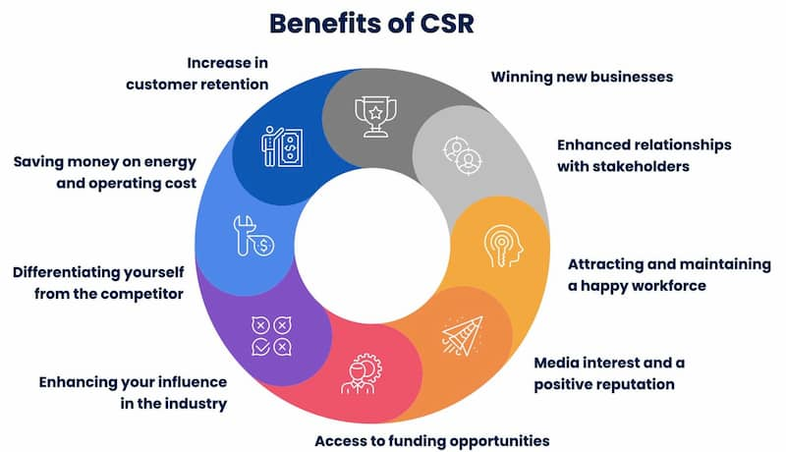
Benefits of CSR Cultural Change Implementation
Source

Slide 23
Benefits Attained from CSR Cultural Management
21st Century Reputation Enhancement
CSR builds company brand and reputation as it builds on 21st century values such as trust, credibility, reliability, quality and consistency.
CSR is documented to have a positive effect on a company’s competitive position and increases financial performance through reputation enhancement. (Source)
Govindan et al. [59] proved that CSR practices influence the suppliers’ selection, which affects corporate competitiveness.
Stakeholder Satisfaction
Applying strategic CSR management optimizes key stakeholders’ satisfaction and meets their expectations. Hence, selecting key stakeholder groups such as suppliers is crucial to applying strategic CSR. (Source)
CSR is a reciprocation mechanism that creates benefit for existing stakeholders. This mechanism improves the cooperation and partnership between the company and its stakeholders (Source)
Strategic During a Crisis & Risk Mitigation
SMEs are expected to manage not just their bottom line but are scrutinised of their activities and impacts. Supply chain or environmental issues can be crucial commercially. During crises trust between stakeholders and companies is built through socially responsible investment (SRI). Employees’ productivity is higher for socially responsible firms and creditors have more faith in these firms’ transparency. CSR strategies tend to reduce internal and external conflicts especially when it concerns pressing issues such as internal, environmental and social issues.
Source
Source
Source

Slide 24
Benefits Attained from CSR Cultural Management
Enhanced ability to recruit, develop and retain staff
Employees are not only front-line sources of ideas for improved performance, but are champions of a company for which they are proud to work with. This enhanced ability can be the direct result of employees or managements pride in the company’s products and practices, or from introducing improved human resources practices, such as “family-friendly” policies. It can also be the indirect result of programs and activities that improved employee wellbeing, morale and loyalty.
Improved innovation, competitiveness and market positioning
CSR is as much about seizing opportunities as avoiding risks. Drawing feedback from diverse stakeholders can be a rich source of ideas for new products, processes and markets, resulting in competitive advantages. For example, a firm may become certified to environmental and social standards so it can become a supplier to particular retailers. The CSR history of good business has always been one of being alert to trends, innovation, and responding to markets. Increasingly, mainstream advertising hinges it key messages on environmental or social benefits of products and services (e.g., hybrid cars, ethically produced coffee etc.).
Enhanced Operational Efficiencies and Cost Savings
CRS instigates flow improved efficiencies identified through a systematic approach to social and environmental management that requires continuous improvement. For example, assessing the environmental and energy aspects of an operation can reveal opportunities for turning waste streams into revenue streams (wood chips into particle board, for example) and for system-wide reductions in energy use, and costs.
Source

Slide 25
Benefits Attained from CSR Cultural Management
Improved ability to attract and build effective and efficient supply chain relationships
A company is vulnerable to the weakest link in its supply chain. Like-minded companies can form profitable long-term business relationships by improving standards, and thereby reducing risks. Larger companies can stimulate smaller firms with whom they do business to implement a CSR approach so both are on the same team. For example, some large apparel retailers require their suppliers to comply with workers rights, codes and standards.
Enhanced ability to address change
Increasingly, companies are using CSR as a “radar” to detect evolving trends in the market. They are adamant to be innovative and sustainable.
A company with its “ear to the ground” through regular stakeholder dialogue and customer demand is in a better position to anticipate and respond to regulatory, economic, social and environmental changes that may occur. They are constantly in the planning and change mode of their business development.
More robust “social licence” to operate in the community
CSR can help build “social capital” therefore ambassadors, support and loyalty. Improved citizen, community and stakeholder understanding of the company and its objectives and activities translates into these improved stakeholder relations. Stakeholders in the community are anyone external to the SME e.g., government, groups, employee pools etc. This, in turn, may evolve into more healthy robust activities that build public, private and civil society alliances. All of which build CSR reputation.
Source

Slide 26
Benefits Attained from CSR Cultural Management
Access to capital
Financial institutions are increasingly incorporating social and environmental criteria into their assessment of projects. When making decisions about where to place their money, investors are looking for indicators of effective CSR management. A business plan incorporating a good CSR approach is often seen as a proxy for good management
Flammer [63] highlighted how responsible companies are favoured and receive more government procurement contracts due to the stakeholders’ interest consideration and incorporating CSR activities.
Improved relations with regulators
In a number of authorities, governments have expedited approval processes for firms that have undertaken social and environmental activities beyond those required by regulation. In some countries, governments use (or are considering using) CSR indicators in deciding on procurement or export assistance contracts. This is being done because governments recognize that without an increase in business sector engagement in social, economic and environmental spheres government sustainability goals cannot be reached
A catalyst for responsible consumption
“Responsible consumerism” is not exclusively about changing consumer preferences. It is also about what goods are supplied in the marketplace, their relationship to consumer rights and sustainability issues, and how regulatory authorities mediate the relationship between producers and consumers. Companies changing unsustainable patterns of consumption is widely seen as an important driver to achieve sustainable development. They have a key role to play in facilitating sustainable consumption patterns and lifestyles through the goods and services they provide and the way they provide them. People are watching.
Source

Slide 27
Activating CSR Cultural Change Management Short-Term Strategy Approach
Section 4

Slide 28
CSR is Worth it for SMEs but Don’t Complicate the Process!
‘Don't be put off by the terminology and the impression that you need to achieve the impossible – setting up and running a healthy business is hard enough without worrying about your conscience’. (Source)

Slide 29
Activating and Building a Corporate Social Responsibility Culture
Start small: CSR ideas for Small Businesses to Get The Ball Rolling. (Examples and tools on how to start small e.g., give but not give money, collaborate with other CSR businesses, source green suppliers…)
Building a Corporate Social Responsibility (CSR) culture within a Small to Medium Enterprise (SME) is possible, regardless of its size and business model. CSR is an ever-evolving model.
Need both short and long-term strategies. Businesses don’t need to complicate things by starting at the end. It needs both short and long-term strategies regarding its priorities, resources needed, motivation and implementation.
Pick a model that suits the size of your business size and model. Companies can adopt CSR activities, procedures and policies and create a ‘CSR Culture’ irrespective of their size or business model. One thing is definitely creating a ‘CSR Culture’ can effectively benefit a business.
Source

Slide 30
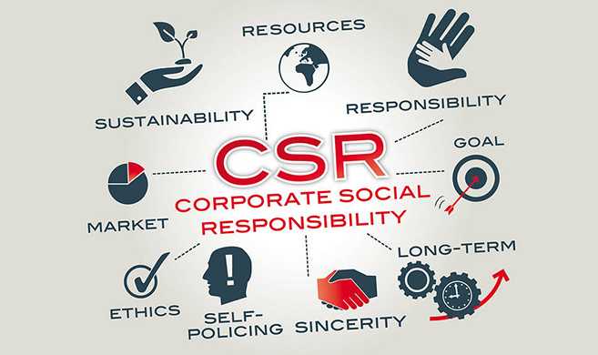
Quick Reminder on CSR Cultural Change Focus Areas
Source
The S&O Center, home of CSR at HEC Paris, advocates that a good CSR business strategy should include such responsibility, with its multiple organizational and competitive dimensions, from managing national policies, subsidiaries, activists, and social inequalities, to new business models (among others).

Slide 31
Quick Recap on CSR Elements for Businesses
The World Business Council for Sustainable Development has described CSR as the business contribution to sustainable economic development. Building on a base of compliance with legislation and regulations, CSR typically includes “beyond law” commitments and activities pertaining to:
Corporate governance and ethics
Health and safety
Environmental stewardship
Human rights (including core labour rights)
Sustainable development
Conditions of work (including safety and health, hours of work, wages)
Industrial relations
Community involvement, development and investment
Involvement of and respect for diverse cultures and disadvantaged peoples
Corporate philanthropy and employee volunteering
Customer satisfaction and adherence to principles of fair competition
Anti-bribery and anti-corruption measures
Accountability, transparency and performance reporting; and
Supplier relations, for both domestic and international supply chains

Slide 32
‘Pure’ CSR Implementation
When starting a cultural CSR transformation companies don’t have to embed ‘pure’ CSR in their company’s core product or service. It is ideal to aim towards this goal long term e.g., by developing a more environmentally sustainable supply chain. However, it can be embedded in so many different ways to suit the company and its priorities e.g., focusing on social capital or environmentalism.
CSR cultural change transformation for SMEs is more likely to be a success by starting small and building it gradually. The key is to make CSR strategies and implementation manageable and achievable. Going too big too quickly is often not appropriate, these ‘pure’ CSR strategies can be difficult to achieve.
CSR must be purposeful and deliberate. CSR should not be neglected, ad hoc or a job half done. You are either doing it or not. It deserves attention like any other business priority.
Source

Slide 33
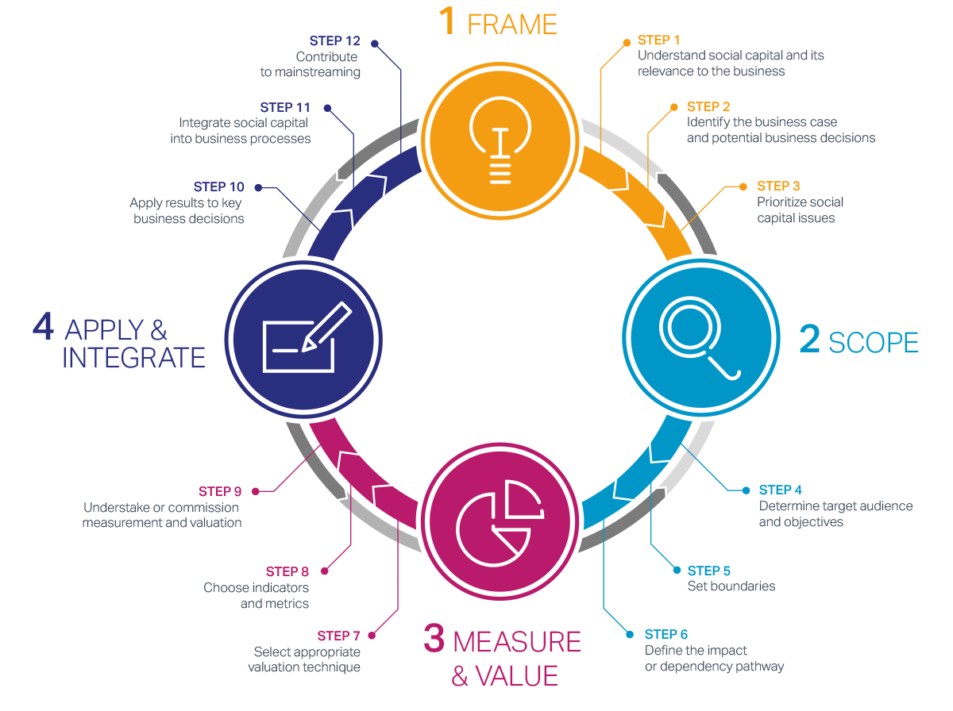
Social Capital Protocol: Making companies that truly value people more successful
Source

Slide 34
How SMEs can Engage in Successful CSR Cultural Change Activities
CSR activities are often relative to SME model, size and resources. Most SMEs understandably do not have resources dedicated to CSR activities. The scope and scale of CSR activities will naturally fluctuate across different SMEs and will be contingent on the business model, size, resources etc.
Top Down Culture is imperative. What is most important is to instil a strong culture of CSR from the top down where all personnel become engaged and involved in CSR initiatives. There is a distinction between embedding CSR in company culture comparably with couching CSR in core services/products. Integrating CSR into the culture will be heavily influenced by leaders’/employees’ values, attitudes and behaviours. It is these intangibles that will drive the development of CSR strategies, tactics and operations.
How to Start a CSR (Corporate Social Responsibility) Program
Seven steps to pitching and launching a CSR program
Source

Slide 35
The Need and Appetite for CSR in European Companies Is Higher Than Ever
People are more aware than ever of the significant impact and the effect the activities of the private sector has on employees, customers, communities, the environment, competitors, business partners, investors, shareholders, governments….and others.
Times have changed we understand what responsible, and businesses doing good means and looks like. It has become good management building trust with the community and giving firms an edge to attract good customers, suppliers and employees. Acting responsibly towards workers and others will help you stand the test of time and endure sustainably.

Slide 36
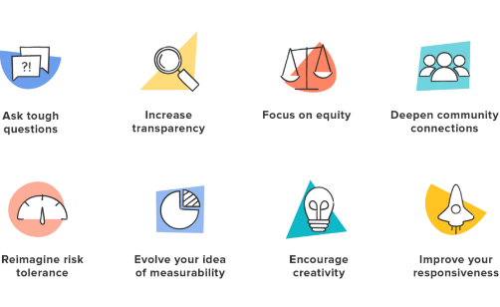
8 Steps to Improve Your CSR Program
Since COVID Demand has increased on Businesses to Have Accountability and Be Responsible
42% of millennials have “begun or deepened” their relationships with businesses they believe have positive impacts on society or the environment. (Deloitte)
70% of Gen Z consumers try to buy from companies they consider ethical. (McKinsey)
Ask the tough questions
Increase transparency
Focus on equity
Deepen community connections
Reimagine risk tolerance
Evolve your idea of measurability
Encourage creativity
Improve your responsiveness
8 Ways to Improve Your CSR Program for Meaningful Impact

Slide 37
How SMEs can Engage in Successful CSR Cultural Change Activities
Embedding CSR into the core business or as an addition. Depending on their business model SMEs may incorporate CSR in their core business or product, or have CSR as an addition to company activities and employee benefits.
Examples include things such as dedicated paid volunteering days, flexible work arrangements that accommodate volunteering during work hours
Start with developing a ‘CSR calendar’ which includes initiatives across the company, ‘donation matching’ or a range of other activities for example pro bono consulting services. Philanthropy, should not be the only focus of CSR policies. In order to have the greatest value it is imperative that SMEs select initiatives that resonate with their business, employees and key stakeholders. These types of initiatives can generate several benefits discussed in the next slide.
Template 3 Month CSR Calendar
Sample Monthly Community Impact Calendar

Slide 38
“There is no way to avoid paying serious attention to CSR: the costs of failing are simply too high. There are countless win-win opportunities waiting to be discovered: every activity in a firm’s value chain overlaps in some way with social factors—everything from how you buy or procure to how you do your research—yet very few companies have thought about this. The goal is to leverage your company’s unique capabilities in supporting social causes, and improve your competitive context at the same time. The job of today’s leaders is to stop being defensive and start thinking systematically about corporate responsibility.”
Michael Porter, Professor, Harvard Business School

Slide 39
Let’s Zoom in on the Benefits of CSR Cultural Transformation!
Reputation and Competitive Advantage. There is significant practical research which substantiates the impact of CSR activities on a SMEs reputation and competitive advantage.
Attract and Retail Skilled Employees. CSR can have a direct impact on attracting and retaining skilled employees. Employee attitudes and behaviours drive company culture and climate and therefore CSR activities can play an integral function in this context. Motivation and commitment to helping others can enhance employees’ affinity with their employer.
Stimulate a Culture of Innovation. CSR programmes can help stimulate a culture of innovation within SMEs. Where CSR culture is conducive to helping other people and benefiting society, employees may feel more inclined to be creative which can have a knock-on effect on other areas of their output.
Positive Purpose Driven Employee Development. CSR activities can facilitate both personal and professional development for employees. For example, when employees volunteer for team-based CSR activities this may subsequently create bonds and improve working relationships and therefore enhance their ability to work more effectively on other business projects. This is perhaps even more pertinent for SMEs where employees work in smaller, more intimate environments.

Slide 40
Managing SME Financial and CSR Cultural Change
Financial Benefits. Quantifying the financial benefits of CSR activities can be difficult to assess, particularly in the beginning and short term. Many SMEs engage in CSR activities but without profitability on a corporate level, it is not sustainable. This becomes even more critical for SMEs who naturally do not possess the same level of financial clout or resources as large corporations. It is important not to take a biased view of CSR investment.
Reputational or ethical CSR practices will arise at several levels and frequently at fluctuating points in time. In the medium to long term, an effective CSR strategy can help transform company culture and how the firm sees its role in the world. Company culture and CSR are at the essence of value creation using a holistic internal and external approach and therefore will engender several benefits for the environment, economy and socially.

Slide 41
Final Note Develop an Engaged CSR Culture Business Case
‘SMEs must establish the case for CSR by defining the social and environmental practices that are most relevant and important to the nature of their business and their key stakeholders (Loucks et al, 2010).
‘CSR has both an internal and external focus. Externally, CSR initiatives focus on benefiting society and the environment more broadly. Internally, an engaged company culture which promotes well-being can improve job satisfaction, and productivity and reduce turnover. These benefits to organisational culture, performance and subsequently ‘bottom line’ effectively reinforce the concept of ‘The business case for CSR’ for SMEs’ (Source)

Slide 43
Well Done!
You Have Completed Module 4
Next is Module 5
Embracing CSR and Cultural Change Transformation (Long Term Strategy)
https://www.csrready.eu/
Facebook

