Slide 1
Module 3
Implementing CSR HR to Maximize CSR SME Potential
"The European Commission support for the production of this publication does not constitute an endorsement of the contents which reflects the views only of the authors, and the Commission cannot be held responsible for any use which may be made of the information contained therein 2020-1-DE02-KA202-007503’
This resource is licensed under CC BY 4.0

Slide 3
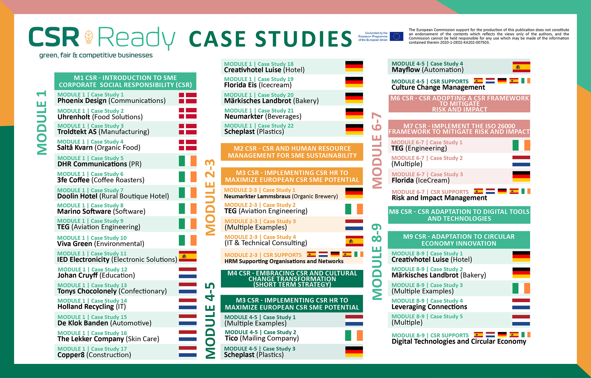

Slide 4
Overview of Module 3
1
This Module provides step-by-step guidance on how to implement an HR CSR cultural change management strategy focusing on employee engagement and CSR integration. The steps are
Vision, mission, values and strategy so that CSR is understood and integrated into the company’s DNA
Employee codes of conduct so that certain standards of behaviour are understood and implemented
Workplace planning and recruitment so that CSR is part of the overall communication, training and other recruitment processes
CSR orientation, training and competency development
Fostering CSR change management
How to Implementing an SME CSR HR to Support Your CSR Cultural Change Management Strategy
This full section focuses on 5 key areas that should be first addressed for the successful integration of CSR HRM Management Strategies
2
Learning Outcomes

Slide 5
Learning Outcomes
Learn the five-step approach to implementing CSR HR so it is fully integrated into the company’s DNA
Understand HR is a key CSR partner and can take the lead or partner with managers to work cross-functionally to integrate CSR objectives into how business gets conducted.
Understand that HR can act as a key company driver in employees’ CSR commitment vertically and horizontally across all departments.
Explore the different CSR HR methods that suit different businesses depending on their values, mission, and vision.
Realize that CSR is not an expense, it is an investment and required by today’s customers and employees.

Slide 6
How to Implement CSR HR for SMEs
Cultural Change Management Strategy
Section 1

Slide 7
A Well Integrated HR CSR Cultural Change Management Strategy Retains Employees
A well-developed cultural change management strategy is inclusive of a performance and talent management strategy with embedded CSR components. It is designed to embed CSR elements and objectives in order to reduce the likelihood and impact of losing employees and increase a reputation that attracts potential new employees.

Slide 8
CSR HR Strategy – First Needs a HRM (Human Resource Manager)
Companies (including SMEs) need an HR manager or HR expertise in CSR strategy development and implementation. HR is a strategic partner in the company’s HR development and implementation. They can drive the formulation and implementation of the CSR strategy using an important “people perspective”. That means they need to be involved in each stage of the;
CSR Business Plan and Strategy. HR can provide CSR HR guidance for the Business Plan and provide Strategic Direction from an HR perspective so that CSR can be embedded at all levels of the company. This includes people, policy, and HR strategy development, support, training, CSR employee programs, etc.
If you do not have the in-house expertise of HRM, they can be sourced via a consultation or a mentoring role.

Slide 9
When CSR is embedded in mainstream business strategy it becomes a mechanism for unlocking human potential,"
Corostrandberg
‘
‘
CSR + HR + BS = Human Potential

Slide 10
Step 1 Vision, Mission, Values and Strategy

Slide 11
HR is Imperative for CSR Cultural Change Implementation
Impact Assessment
Companies are expected to take into account the impact of their activities on society, the environment, and the economy. HR is armed with the skills and resources to assess the impact on employees and people.
HR is Central to a Company-Wide Cultural Change
HR are the experts with the relevant knowledge and skills for the company to learn and culturally change to CSR
HR Key for Effective Delivery
HR is responsible for many of the key systems and processes e.g., recruitment, training, communications, and retention. Effective CSR delivery depends on these systems and processes.
Managing People Manages Risk
Managing company trust and risk is fundamentally affected by how people are managed
Employees are Priority Stakeholders
Employees are a priority stakeholder in any CSR Program
Credibility Requires Action
It’s no longer good enough to just say you do good, you have to deliver too
Source CIPD, 2002, P15

Slide 12
Step 1: Vision, Mission, Values and Strategy
This is the first step to building CSR into a company’s DNA and its operating and strategic framework.
Successful CSR implementation requires a clearly thought-out vision, mission, and value statement. If you do not currently have these statements developed with CSR embedded HR can support the development and update them to address CSR. Once the vision, mission, and values framework are defined, the firm is ready to undertake the development of its CSR strategy
HR can outline the need and opportunities of CSR and how it can add to the ROI of the company. They can align why it can be both a good business strategy and a good people strategy.
The manager can bring the opportunities to the attention of the senior executive and the board on what it means (from both angles Human and Business), and explain why it makes good business sense. Ideally, employees and other stakeholders would be involved in the development of the corporate vision, mission, and values, more of which will be said later.

Slide 13
Why a Vision Statement?
Vision Statement demonstrates why an organization does what it does.
The Vision Statement sets the future direction for the company and what it is aiming for in 5, to 10 years +.
It expresses what the company is striving for in the long-term future, how the company works, and how it is and will be guided by its CSR values so it can find the right balance between commercial interests and act as a responsible business.

Slide 14
Why a Mission Statement?
The Mission Statement demonstrates how the Vision Statement will be achieved. It describes the company’s values, commitments, actions, and activities that will occur during the present often in a daily capacity. It focuses on business objectives, customers, compliance, collaboration and sharing of better practices, and a quality mindset. These actions need to be underpinned by CSR and commitment to the triple bottom line (i.e., social, environmental, and financial) and sustainable development.

Slide 15
CSR Needs Company Vision and Staff Commitment
Overarching CSR Vision
Companies with a good CSR reputation have CSR as part of their overall Vision. A CSR Vision makes sure the company’s behavior and that of the people is aligned with CSR values in a consistent way. The Vision embeds CSR values throughout the company building marketplace trust and reputation in both the eyes of the customers, stakeholders, partners, and employees. Another critical success factor for implementing the CSR Vision is having the commitment and support of senior management, managers, executives, and board level. This commitment must be reinforced and supported by HR so they can engage and support staff, and provide the necessary employee strategies, policies, skills, tools and incentives.
Staff Participation is a Priority
Sustainable HR management combined with CSR is key. Employees are SMEs, the top four priority stakeholders, the others being shareholders, customers, and communities. Staff participation and buy-in to delivering company CSR objectives are central to its successful implementation. HR practices facilitate embedding staff participation through CSR competency development, training, support development of programs, etc. CSR objectives should go a step further and be embedded in the SME employee brand and be part of the value proposition for working at a given firm.

Slide 16
HR CSR Protects Company Values
As we examined earlier, business value is becoming more and more about intangibles such as goodwill, reputation, trust, talent, and intellectual capital, making CSR an increasingly important consideration.
As a key driver of CSR sustainability companies require HR to engage employees so CSR can be integrated throughout the company at every level. The employee level is one of the most important implementation levels. HR helps the SME achieve its CSR goals (via its people i.e., employees, managers, directors, etc) and stick to its CSR principles consistent with its strategic business direction. Anything less than full company integration especially with employees will eventually cause negativity and mistrust and lead to reputational issues as there is a disconnect between vision, delivery, and operations.
What HR CSR Resources and Supports Look Like….
Developing the Global Leader of Tomorrow, observed that “a range of human resource levers are important for developing [CSR] company capabilities: building this knowledge and skills through leadership development programs, career development planning, succession planning, performance management, and incentive systems and competency frameworks, and seeking this knowledge and skills when recruiting new talent into the organization”. (Ashridge, 2008, p. 10).

Slide 17
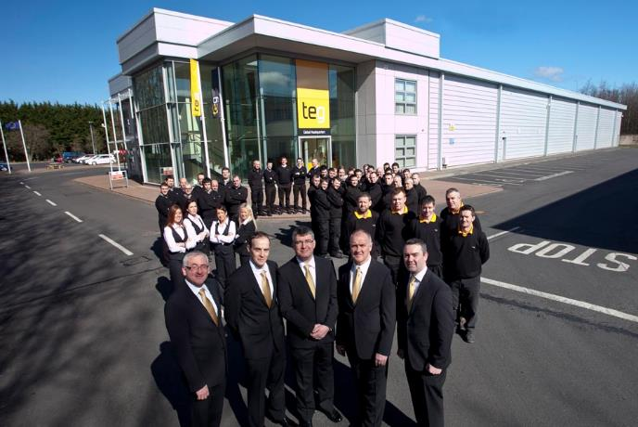
CASE STUDY - TEG, Ireland
Is a leading Irish engineering company supplying the pharmaceutical, bio-pharmaceutical and aviation sectors.
https://teg.com/
TEG CSR and Sustainability Strategy
Each year TEG offers an intensive four-year Apprenticeship Training Program in Toolmaking. They have a school leavers Higher Education 6 year Program where students can earn while their learning. TEG works with local colleges so workers get the support they need e.g., IT Sligo. The invitation for the Apprenticeship also extends to those on social welfare. Diversity: TEG also encourages women to join their company, however, this has proved difficult in the industry. Of 86 employees, only four are female, one of whom plays an important role on the engineering design team. To support a good work-life balance, TEG offers working flexibility in the instances where family issues arise. Employees may swap shifts to facilitate changes …see full Case Study

Slide 18
Step 2 Employee Codes of Conduct

Slide 19
Step 2: Employee Codes of Conduct
HR is typically responsible for drafting and implementing employee codes of conduct. These are the standards of behaviour expected of employees to ensure the company is effective, open, and accountable and employees have a productive and supportive relationship with other employees, volunteers, and other people they interact with. It is one of the rare documents which all employees are bound by and come into contact with.
HR Managers can include CSR company principles in the Employee Code of Conduct where all staff must adhere to an ethical CSR culture within the company. Employees sign off to commit to 100% compliance with ethical company CSR values.
This document formally expresses and informs employees from the start of the company’s commitment to socially and environmentally-based decision-making and values. As such it is a key tool for SME cultural integration of CSR norms. It is important to define terms that may not be familiar or fully understood such as “sustainability” and “CSR”, and what it means to the company. To also clearly explain with examples the CSR and conduct standards expected from employees.

Slide 20
What does this look like? Environmental Example
HR can include a number of components in its Business Conduct Policy, e.g.,
One that relates to the environment, health, and safety (EHS). HR can develop EHS policy statement mandates for employees to comply with EHS policies, including preventing pollution at the source, developing products that have a minimum effect on the environment, working to improve energy efficiency, and incorporating appropriate safety and health considerations in daily job duties and business decisions.
It can caution employees to avoid “missed opportunities for preventing pollution and reducing waste; missed opportunities to improve energy efficiency; unsafe activities and workplace conditions; and suppliers, outsource manufacturers and service providers who do not share (company name) environmental, health and safety values”.

Slide 21
Step 3 Workplace Planning and Recruitment

Slide 22
Step 3: Workplace Planning and Recruitment
The World is Transforming Meaning Companies and Workforces Need to Follow to be Sustainable. The new “green economy” means the marketplace is transforming and companies need new or additional competencies and skills to support their CSR transformation.
For a CSR SME, this consists of evaluating existing CSR skill sets and competencies that are needed for the business to operate as a business contributing to a sustainable economy, environment, and society. These skills will help the SME to assist, prevent or minimize social, environmental, and economic challenges in its own organization ultimately contributing to the overall global cause e.g., resource and energy scarcity, human poverty, environmental degradation, change in negative societal behaviors, and government expectations.
Examples of CSR competencies and skills; are accountability and ownership; time and deadline management, practical problem-solving and judgment, communication, coaching, and working with others

Slide 23
There are multiple competencies and skills that can be developed to strengthen and support business CSR sustainability commitments and values.
Strategic Thinking
Ability to Learn & Develop
This will ensure you are seeing the bigger CSR picture and help you be innovative by asking the right questions, you are considering all impacts involved and you are ready to challenge yourself and embrace different ideas. A great CSR strategy will be easily implemented and followed.
CSR sustainability is constantly evolving and requires a lot of learning how to do things differently and better. Being passionate about CSR is the first step to learning how.
Communication
Adaptability
Strong communication skills go hand in hand with CSR training, problem-solving, strong decision-making, great listening, finding and explaining solutions, understanding impact and how to recognise others ideas.
Need to be able to change quickly and be ready to adapt your CSR strategy and action plans at any point in time. Need to be flexible in thinking and easily adapt once you identify impacts or solutions.
Underpinned by Strong Leadership and HR Commitment
Source csrgrowth

Slide 24
Step 3: Workplace Planning and Recruitment
2
Workforce CSR Planning consists of…
Identify Future CSR Competencies
Identifying CSR competencies needed in the future by assessing what is needed and the competency gaps and surpluses. Future CSR competencies include foresight thinking, critical thinking, CSR management, and understanding (more examples) But before staff can become CSR competent they need to learn and be trained in CSR and CSR competencies.
1
Analyze Current CSR Competencies
Analyzing your current workforce CSR competencies (i.e., knowledge, skills, abilities, behaviors) that contribute to the individual and current company CSR performance. They will be different depending if the company is new or experienced in CSR implementation.
3
Prepare a plan how to build the workforce needed to sustain future CSR objectives
4
Evaluate to assure the workforce CSR competencies are still valid, CSR culture and activities are being maintained, and that CSR objectives are being met.

Slide 25
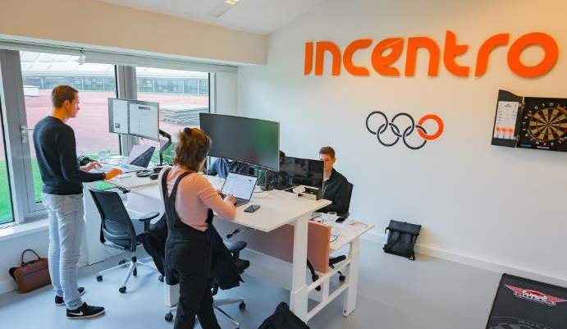
Incentro, Spain
Incentro are IT consultants who build digital solutions, creators of digital transformation, architects of mind-blowing customer experiences.
https://www.incentro.com/en/home
Case Study
Boldness, mastery, and autonomy. These are the main characteristics of the profiles that are part of Incentro's team. People who are not afraid to face a challenge and who are persevering. They seek change. They are called Changers. Traineeship. Each YPA’er has its expertise and with each expertise comes a different specialization course. This way, everyone gets the most value from the YPA, as you’ll be learning more about subject-specific matters. Win-win because you’ll become an expert, plus you'll have the time to share your experiences and knowledge with other YPA’ers. After this traineeship, there is an opportunity to start as a real consultant at Incentro.…see full Case Study

Slide 26
Step 4 Orientation, Training and Competency Development
Human resource managers understand the win-win when CSR is integrated into employee career paths, training, and succession planning, particularly for high-performance individuals. Employees should be encouraged from the beginning to advance their careers and be CSR orientated so they become motivated, more loyal, and therefore more productive employees.

Slide 27
During orientation, employees should be given the company’s vision, mission, and core CSR values and goals.
CSR strategic direction should be mandatory for all levels of new employees during orientation. New employees need to be provided with a copy of CSR information as an important element of new employee orientation programs.
CSR Orientation Information
Vision, Mission
Core CSR Values and Goals incorporating the SDGs
Future CSR activities and events
CSR policies, strategies, and commitments
The key CSR issues the company faces and the key stakeholders engaged
How the company measures its CSR performance
The annual sustainability or CSR report
Finally where they can find further company information on CSR

Slide 28
It is vital to make CSR an integral part of management and HR training programs.
From Step 3 management and HR, we have identified the required CSR competencies the company needs and will need in the future. They should have identified and developed the CSR training, learning plans, and programs needed to address any anticipated CSR competency gaps. They should continue to work together to understand and deliver key SME CSR training and objectives.
CSR Training Delivery
Once inducted, employees should be provided with CSR training on an annual/regular basis.
Employees will either have direct CSR responsibilities (e.g., energy manager) or indirect CSR responsibilities (e.g., payroll clerk).
Those with direct responsibilities will receive technical and specialized training in CSR while those with indirect responsibilities should receive training in top-priority CSR issues of a more general nature.
Either way, CSR training should be job-relevant for strategic CSR sustainability.

Slide 29
Neumarkter Lammsbräu, Germany
An organic-certified beverage producer that has mantained a culture of sustainability for around 40 years
https://www.lammsbraeu.de/
Case Study
CSR Onboarding and Recruitment Process
"Participate and belong right from the start" Whether through one of the two apprenticeships, a working student job, or an internship practice-oriented learning is combined with a family environment and CSR topics covered. Open and transparent interaction is an integral part of this: for example, regular feedback meetings are held with the trainee managers as part of the training, as are annual trainee…see full Case Study

Slide 30
Spotlight on CSR in Succession Planning
Succession planning is a form of recruitment where the strategy for replacement planning is on leadership roles. It is used to identify and develop new and potential leaders who can move into leadership roles when they become vacant. It reduces recruitment costs and ideal existing employees are available to fill vacancies. They feel appreciated and recognized, especially those who are on a progressive career track.
Career mapping and succession planning programs could incorporate CSR experiences either within or outside the company, for example through secondments to social or environmental organizations or assignments, or leaves to pursue CSR-related executive work experience, to prepare the individual for CSR leadership as well as general management roles.
Follow simple measures, such as integrating CSR values into all training programs such as orientation and on-site. This will ensure all employees are aligned and inspired from the beginning and understand this measure as a progressive avenue.

Slide 31
Example of CSR Competency and Performance Management
Next to recruitment and competency development, compensation and performance management are central to the HR CSR function. HR is involved in setting performance standards and expectations and monitoring results to performance objectives.
Integrating CSR-oriented Statements of Values and Commitments into HR, business planning, objectives, and management accountabilities will continue to sustain and ingrain their CSR as a differentiator.
HR managers should integrate CSR elements into job descriptions, individual performance plans, and team goals.
For example, have CSR principles incorporated as a key area of accountability in all manager role descriptions rather than as an added attachment or information document at the end of each role description.
Going forward expand beyond three stated CSR Values e.g., innovation, diversity and environmental responsibility. Translate them to goals with KPIs (e.g., amount of energy or waste savings) in the annual performance plans of all managers to be cascaded down to each of their support staff.

Slide 32
The most critical HR tool of all is the compensation and incentive program. Human resource practitioners understand very well that “you get what you pay for”. Typically, companies reward on the basis of financial performance and profit-maximizing behaviour, overlooking the need to also consider CSR sustainability factors.
Therefore, the strategic direction of your company should establish CSR targets and develop performance evaluation systems that foster CSR behavior by providing the right tools and instructions. To do less is to guarantee the under-achievement of a company’s CSR objectives.
Example of CSR Compensation and Incentives
The total incentives and recognition program can include the base salary, incentive pay, long term incentives, and other non-monetary recognition benefits (such as award programs, an employee of the month, promotions, career pathing, etc.), needs to be aligned with the company’s CSR values and strategy.
For example, have a CSR goal with a bonus attached so it is attained and generates take-up at all levels of the company. To help with implementation, HR should work with the task manager to prepare guidance documents on potential sustainability goals that can be measured and built into their performance plans. CSR performance should be based on both teams and individuals.

Slide 33
Example CSR Remuneration Package
Reward individuals and teams for performance that meets or exceeds the financial and non-financial targets in a balanced scorecard, which comprises corporate, unit-specific, and individual targets. Nonfinancial performance can be guided by measures of the company’s triple bottom line e.g.,
Socio-economic impacts (e.g., job creation for those who need skills development or formal education)
Reduction in environmental impacts and optimize resource efficiency (e.g., waste targets reduced, increased usage of recyclable materials)
Social impacts related to employees, customers, and communities (e.g., improved employee health and wellbeing, reduced poverty due to funds raised)
Other nonfinancial measures include improved customer satisfaction, awarded reputation, better employee engagement, improved health and safety, greenhouse gas emissions, etc.

Slide 34
Step 5 Fostering CSR Change Management
The move to incorporate a CSR ethic throughout a company necessitates a CSR change management approach. Human resources are responsible for the company culture, team building, and change management processes. Growing and adapting to CSR will require the company to constantly evolve and pursue significant behavioural shifts from time to time. Sometimes HR and companies may require the outside assistance of change management professionals to help them but at the end of the day, a culture shift can only be achieved and sustained if it is driven internally.

Slide 35
Examples of Cultural Change Management
Keeping true to the CSR values as a compass is a critical guidepost to change management and team alignment. The values need to be reflected in all processes as explained starting with how you attract and recruit employees, to decision-making and rewards and incentive programs, etc.
Culture change requires setting the tone at the top and then creating alignment throughout the company with the CSR values you are committed to.
Changing Mindsets and Behaviours
Cultural change management often means changing the mindsets and behaviours of all those involved in the company. This can be done by
Explaining what CSR is and how it is relevant to the company (highlighting the purpose, 'The good’, 'The positive impact’, and CSR Values)
Role modeling and engagement
Building awareness of how the individual and company can get involved
Generating desire (what is in it for me?) Generating conviction so employees can strengthen their CSR beliefs
Developing knowledge and ability and reinforcement through incentive programs.

Slide 36
Examples of Cultural Change Management
Change management should identify the different states of readiness of each individual and team for advances in CSR sustainability, or any change for that matter.
Employee Readiness & CSR Grouping
Employees can be grouped by their state of readiness, and you can tailor your change approach appropriately to each group. (Nancy Lee, Founder and President of Social Marketing Inc., 2008, slide 12). Nancy puts them into three readiness groups, labelled A, B, and C, and applies 3 different CSR readiness strategies (see next slide)

Slide 37
Advance CSR by Adjusting Your Cultural Change Management Strategy appropriately to the Readiness of Each Employee . Consider approaches of 3 groups ….
A Have CSR Values and Behaviours
Recognize Group A for their CSR behaviors and achievements and encourage them to continue it with incentives and rewards. Generate company-wide examples and impact by communicating and showcasing their achievements e.g., CSR employee of the month.
B Have CSR Values but not the Behaviours
Promote, incentivize and reward Group B for any behavior changes. Ensure that CSR “tools” are specifically designed so that the benefits are meaningful and the barriers to change are removed for this group. Reward any progress to allow for incremental change.
C Do not have CSR Values or the Behaviours
If you treat each person with the same strategy you risk alienating Group A. Make sure to recognise and reward each group relevant to the level of their CSR behaviours so everyone is treated the same. If Group B underperform the incentives are less e.g., lower bonus for lower waste savings. Leave Group C alone. Do not cut them out, and do not tailor your incentives, etc. to their needs. A large percentage of the C’s will change their behaviour once the Group B’s have changed their behaviour so that they do not stand out as the minority.

Slide 38
Cultivating CSR Change Management Groups
If Group C continue to fall behind, after all, support is provided you need to consider an advanced step (e.g., tailored support or disincentivize) otherwise you could spend a lot of time, effort, and money and never see a return as their motivator is to not be CSR orientated. It is likely there will still be several C’s who will not change. They are usually the minority (and perhaps a group you no longer find a fit for your company).
It is important to advance CSR ethics and training programs with these three Group perspectives in mind. They should be applied to all new and existing staff.
Remember: The company’s CSR culture, or “how work gets done around here is CSR focused”, and ‘how CSR is rewarded’ are key dimensions of a strong CSR Strategy. People need to be rewarded for the way the manager wants the work done. This will attract and retain the best and brightest employees!

Slide 39
Employees are key stakeholders in the development of any CSR strategy or program. Their participation and support are vital to understanding their key concerns, priorities, and perspectives. The need to be part of the CSR change.
Employees consulted and engaged in the development of new CSR programs and approaches are more likely to follow through with implementation.
Examples of Cultural Change Management
Employee Involvement and Participation
Consult and engage your employees in social CSR impact e.g., invite employees to communicate existing community involvement and charitable donations programs to see if you should partner
Engage a CSR Engagement Team to develop and recommended key CSR engagement drivers that are important to them, they should work along with senior management’s interest example in employee well-being, opportunities to improve skills and capabilities, and input into decision-making. To ensure all employee participation a CSR Engagement Survey should be part of the process.

Slide 40
Cultivating CSR Employee Participation
Alternate a charity or cause to support on a yearly basis, so everyone is in with a chance. Invite employees to put forward a charity that is close to them but also aligned with your company’s CSR values
Incentivise employees to join an internal CSR group that meets on company time to conceive and launch CSR initiatives that both green the company’s operations and achieve social value in the community.
Hold CSR Events e.g. host a sustainability fair at your office, and invite members of the community to participate. Both you and the community provide information on environmental footprint reduction, locally available eco-products, and other environmental impact solutions you can work on together.
We have examined how employee CSR engagement can be at the most engaged level. it is important to not miss this step to engage employees so that they stay motivated and loyal. It helps develop an employee value proposition, foster retention, further embed CSR cultural change and enhance recruitment.

Slide 41
Step 6 What have you learnt?
Module 3 has demonstrated how human resource professionals have a key role to play to help a company achieve its CSR objectives. Employee involvement is a critical success factor for CSR performance. Human resource managers have the tools and the opportunity to leverage employee commitment to, and engagement in, the firm’s CSR strategy. High-performing CSR organizations foster a culture of CSR and fully integrate CSR throughout their operations, rewarding and incentivizing CSR decisions and initiatives. Employees prefer to work for organizations aligned with their values; thus, incorporating CSR into the employee brand can enhance recruitment and retention, particularly in tight labour markets.

Slide 42
You have learned that companies including SMEs realize the triple-bottom-line benefits of incorporating sustainability into their DNA and they know it is the right thing to do. For CSR to be fully integrated into its DNA it needs HR to support the people element.
You understand HR is a key CSR partner and can take the lead or partner with managers to work cross-functionally to integrate CSR objectives into how business gets conducted. This requires a commitment to not just saying but doing, with sustainable implementation measures required.
You understand that HR can act as a key company driver in employees’ CSR commitment vertically and horizontally across all departments. There are multiple different ways HR embeds CSR e.g., Cultural Change Management and External HR Strategies (e.g., attraction, recruitment, and retention) approach.
You explored the different CSR HR methods that suit different businesses depending on their values, mission, and vision. Each new method and structure must be thought out starting with low-hanging fruit (what can be done easily first) so that they can be applied practically in their workplace.
You should now realize that CSR is not an expense, it is an investment and required by today’s customers and employees. With the battle for good employees, it is a required HR commitment as many will simply not work for you or choose another company over you if you do not have CSR values in place.

Slide 44
Well Done!
You Have Completed Module 3
Next is Module 4
Embracing CSR and Cultural Change Transformation (Short-Term Strategy)
https://www.csrready.eu/
Facebook

